Slide 1
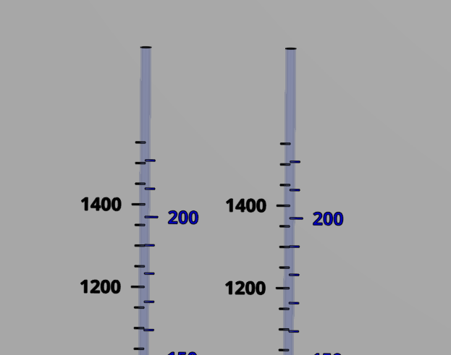
Coagulant
Chlorine
Stock tank
(L)
Calibration column
(mL)
Stock tank
(L)
Calibration column
(mL)

Slide 2
1
2
3
4
5
6
7
8
Notes:
First plants didn’t include filters
Or floc filters
Got the water clean enough so that chlorination could be effective

Slide 3
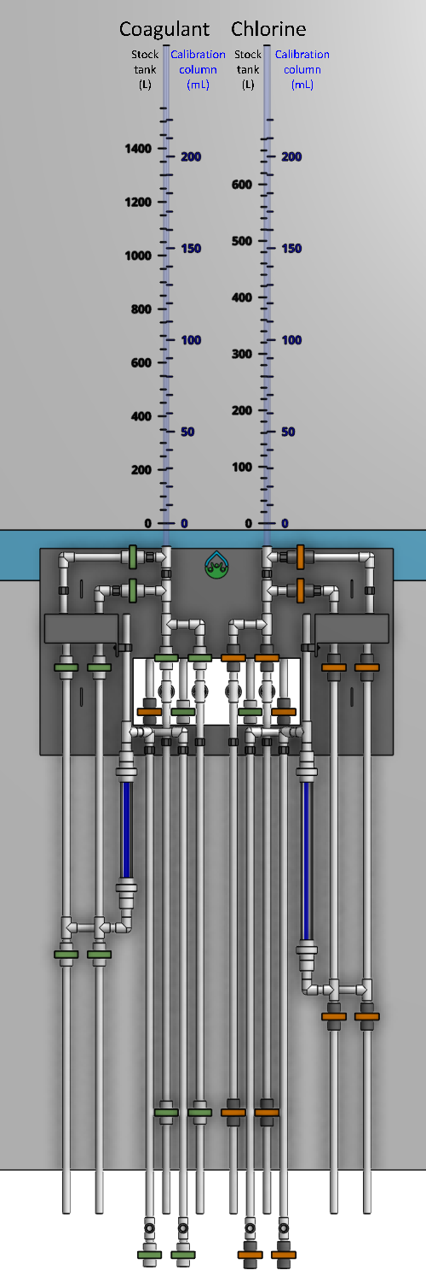
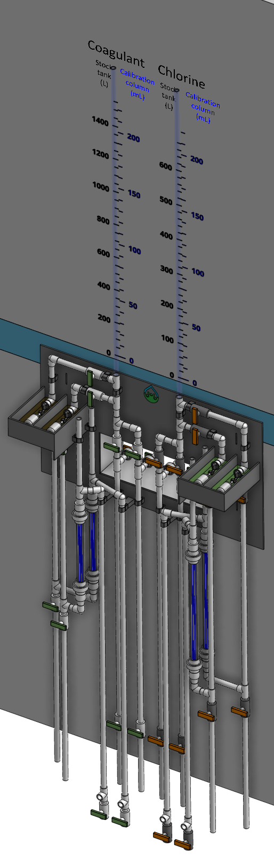
1
2
3

Slide 4
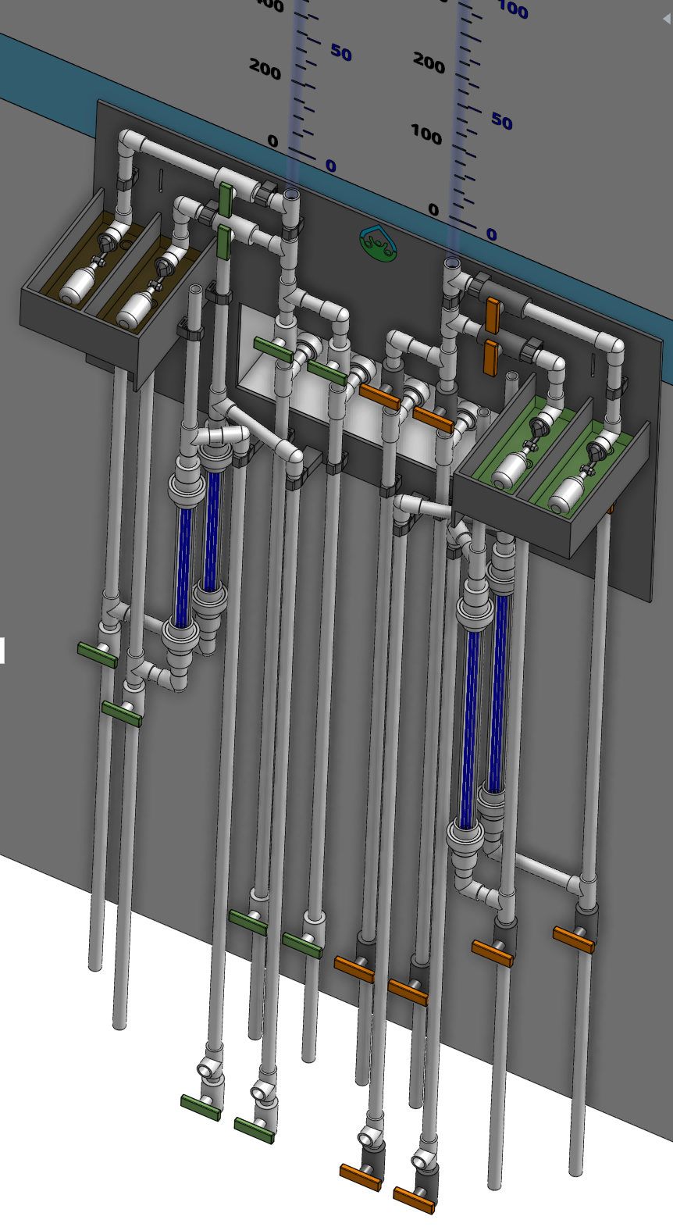
1
2
3
4
5
6
7
8
9
10
11
12

Slide 5
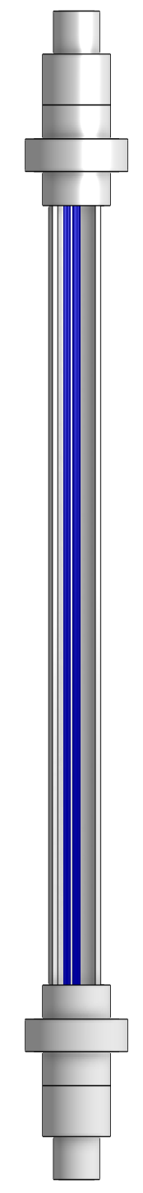
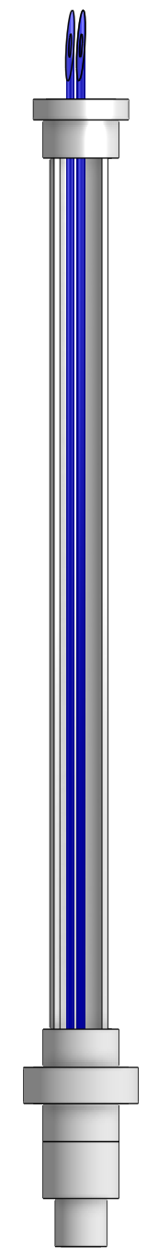
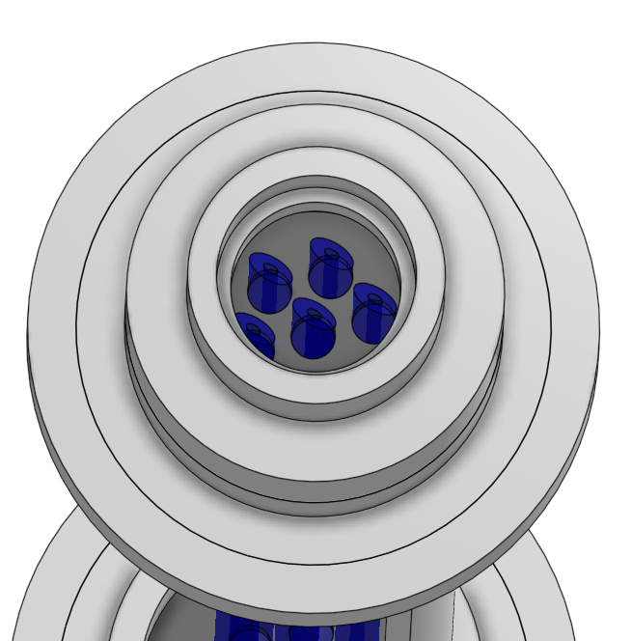
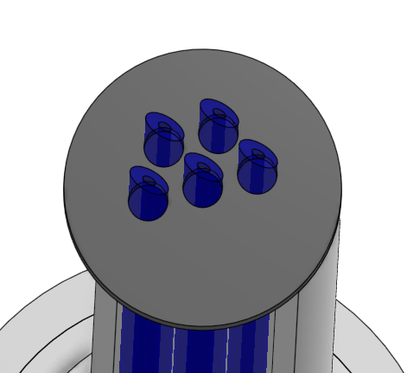
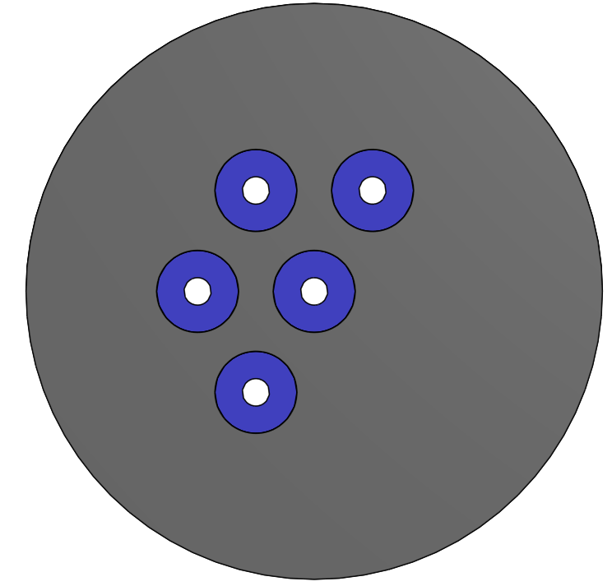
1
2
6
7
3
4
6
5
6
4

Slide 6
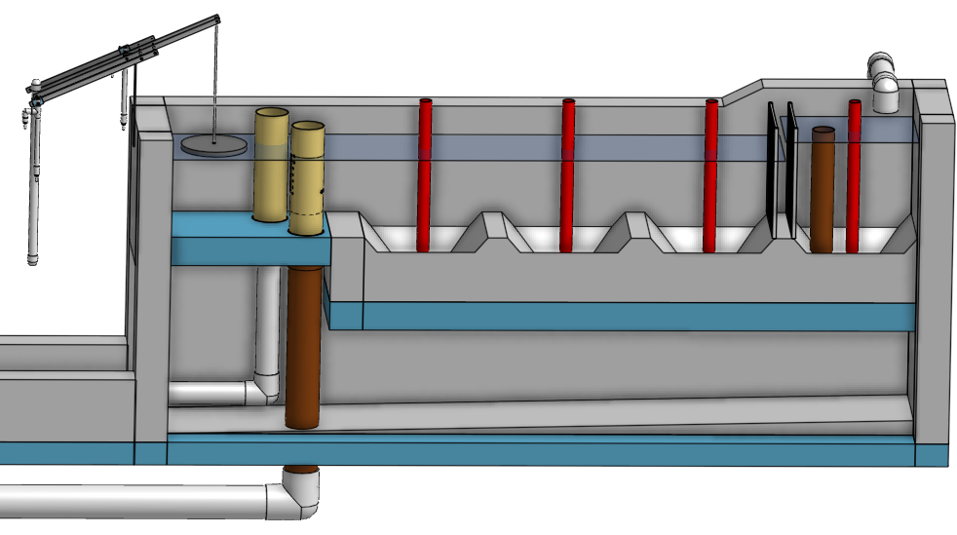
1
10
3
5
6
8
2
4
9
11
7
12
13

Slide 7
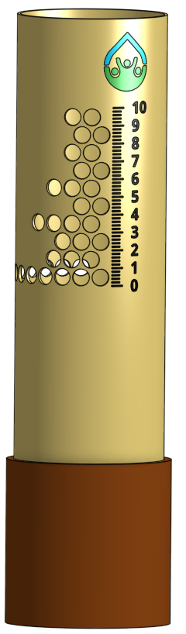
1
2
3
4
5
Notes:
lfom_overview

Slide 8
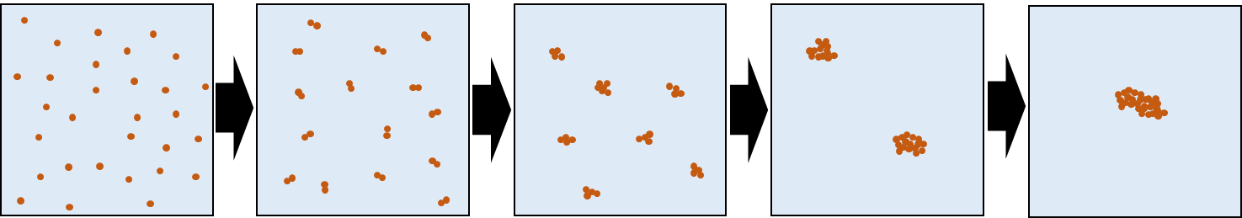

Slide 9
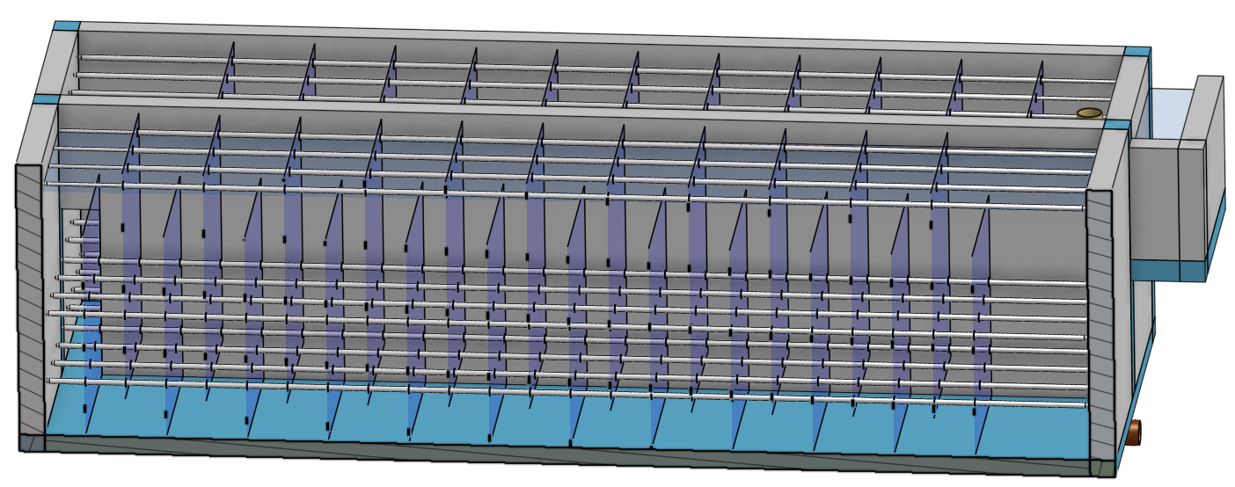
6
7
1
2
3
4
5
Notes:
flocculator_w_flow_path

Slide 10
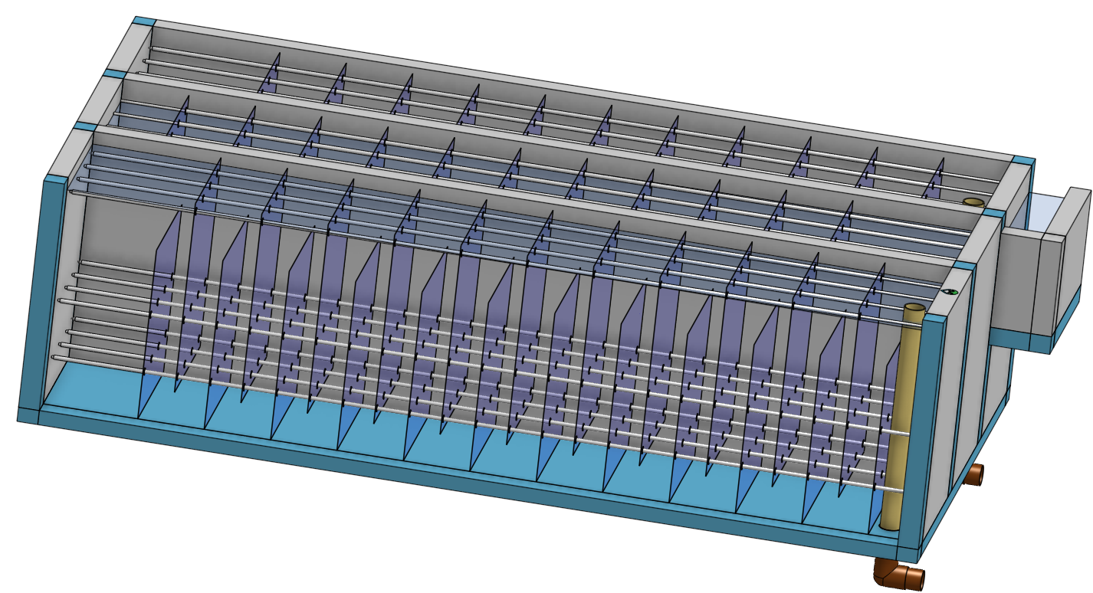
Not used
8
7
6
9
5
1
2
3
4

Slide 11
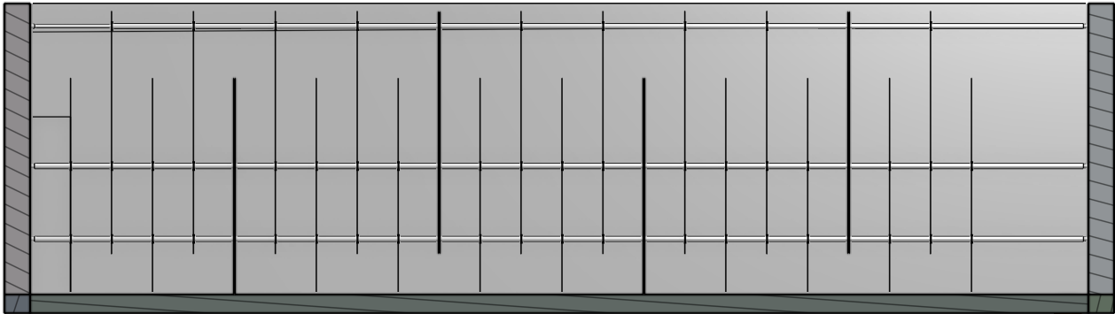
Not used
1

Slide 12
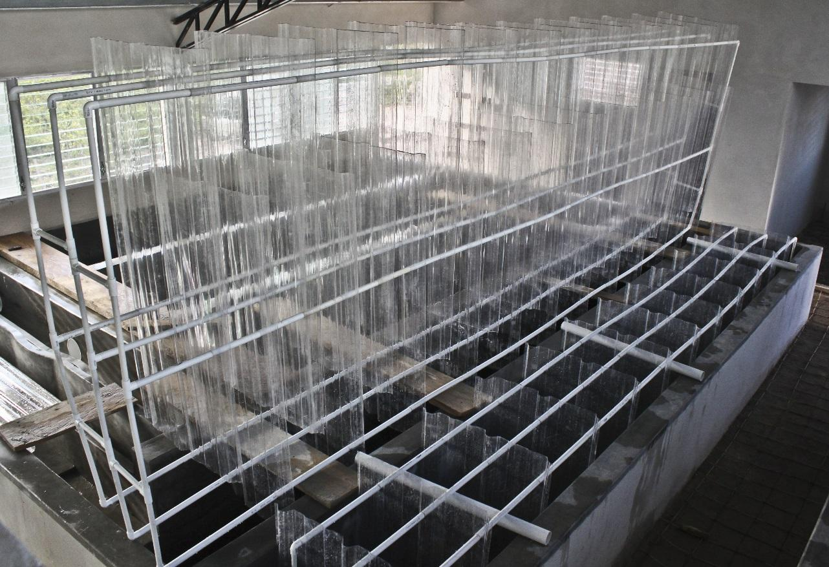
1
2
3

Slide 13
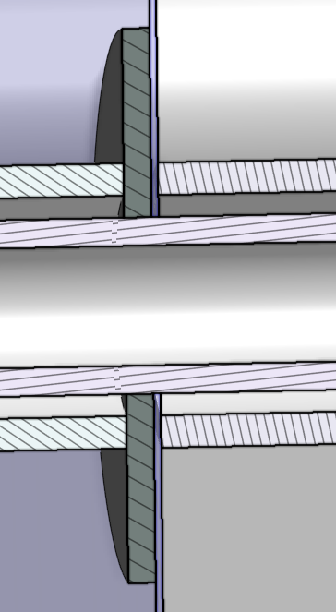
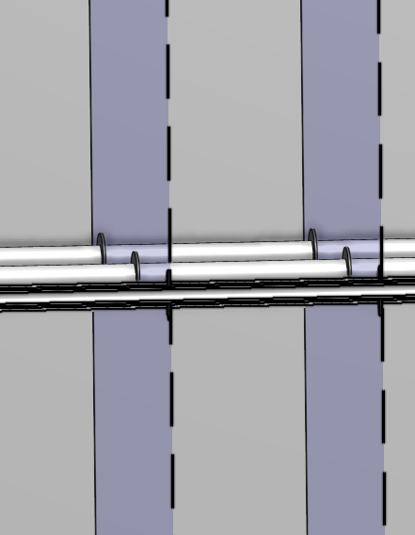
1
2
3
4

Slide 14
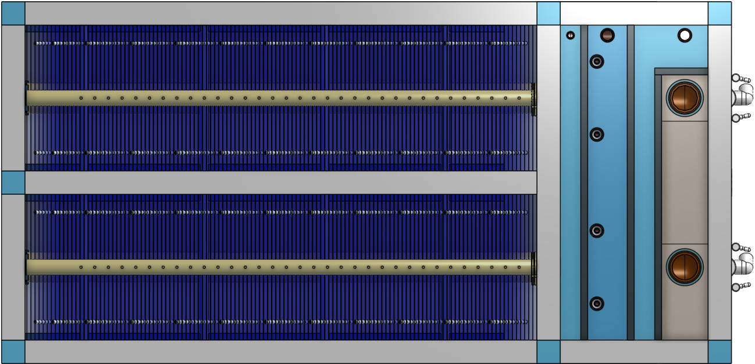
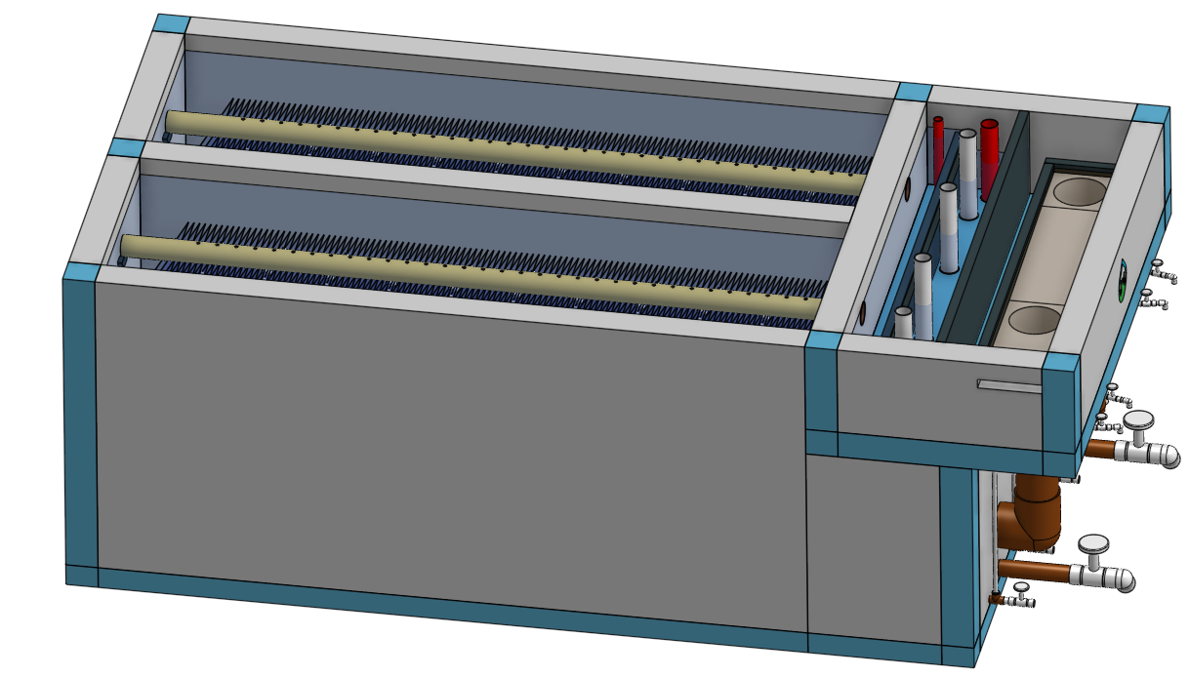
1
2
3
4
5
6
7
8
9
15
13
11
16
14
12
10
1
2
3
4
8
9
6
15
13
11
7
16
14
12
10
Notes:
clarifier_top
https://cad.onshape.com/documents/cb29fe9215c63d736a37e7fb/w/be3111351864b8cc004d74df/e/2546a192555f619bb96446af?configuration=overrides%3D%257B%2522rep%2522%253Atrue%252C%2B%2522repBay%2522%253Atrue%252C%2522ipEnv%2522%253A%2522APP%2522%252C%2B%2522Qm_max%2522%253A8%252C%2B%2522spare%2522%253A0%257D%3Bplastic%3Dtrue&renderMode=0&leftPanel=false&uiState=66b8a4565a9efd706c40153d
clarifier_isometric
https://cad.onshape.com/documents/cb29fe9215c63d736a37e7fb/w/be3111351864b8cc004d74df/e/2546a192555f619bb96446af?configuration=overrides%3D%257B%2522rep%2522%253Atrue%252C%2B%2522repBay%2522%253Atrue%252C%2522ipEnv%2522%253A%2522APP%2522%252C%2B%2522Qm_max%2522%253A8%252C%2B%2522spare%2522%253A0%257D%3Bplastic%3Dtrue&renderMode=0&uiState=66b8b3fb5a9efd706c402e14

Slide 15
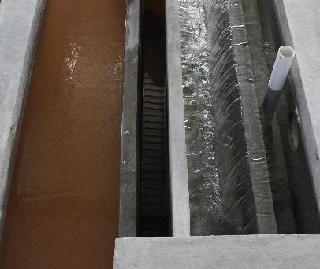
1
16
15
14
13
12
11
10
Notes:
channel_system_photo

Slide 16
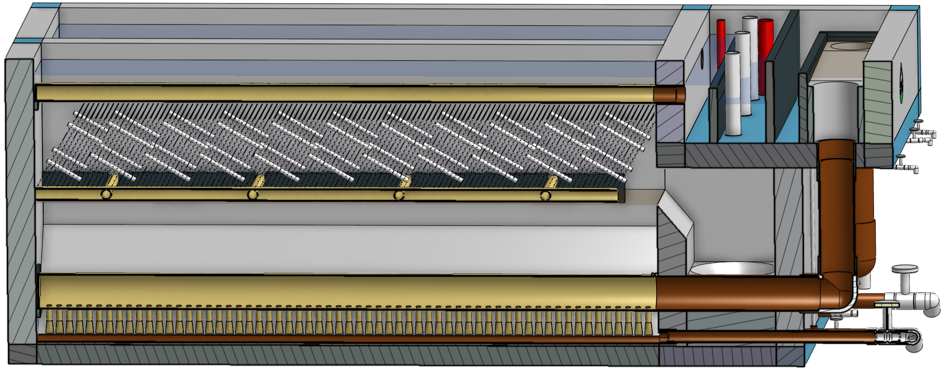
8
5
1
2
3
4
9
6
17
21
7
18
19
20
15
13
11
16
14
12
10
Notes:
clarifier_side_section

Slide 17
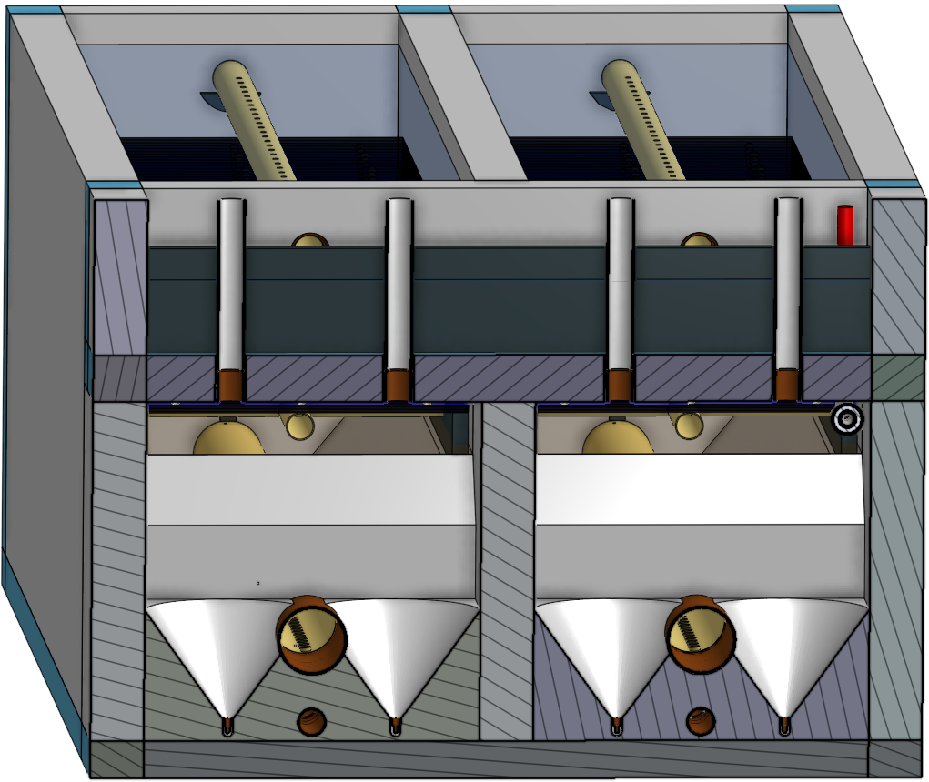
8
17
20
9
21
7
6
Notes:
clarifier_front_section

Slide 18
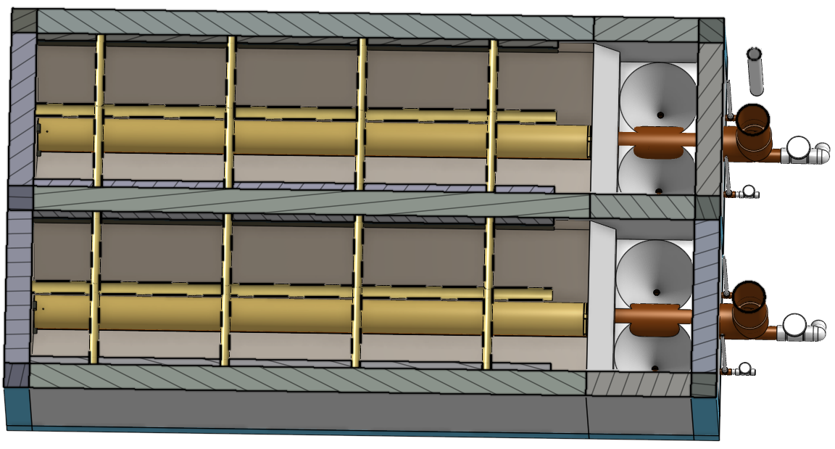
17
20
21
9
7
Notes:
clarifier_top_section
https://cad.onshape.com/documents/cb29fe9215c63d736a37e7fb/w/be3111351864b8cc004d74df/e/2546a192555f619bb96446af?configuration=overrides%3D%257B%2522rep%2522%253Atrue%252C%2B%2522repBay%2522%253Atrue%252C%2522ipEnv%2522%253A%2522APP%2522%252C%2B%2522Qm_max%2522%253A8%252C%2B%2522spare%2522%253A0%257D%3Bplastic%3Dtrue&renderMode=0&uiState=66b8b95e5a9efd706c403b96

Slide 19
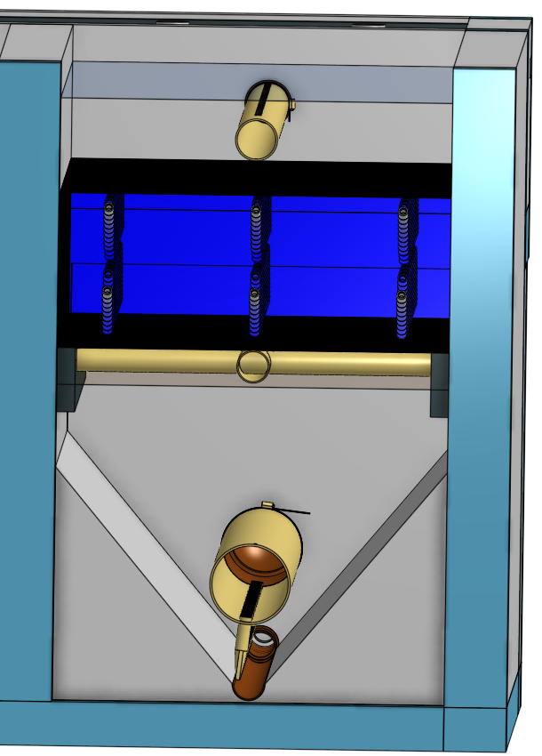
23
1
2
17
24
22
9
18
19
Notes:
clarifier_back_section
https://cad.onshape.com/documents/cb29fe9215c63d736a37e7fb/w/be3111351864b8cc004d74df/e/2546a192555f619bb96446af?configuration=overrides%3D%257B%2522rep%2522%253Atrue%252C%2B%2522repBay%2522%253Atrue%252C%2522ipEnv%2522%253A%2522APP%2522%252C%2B%2522Qm_max%2522%253A8%252C%2B%2522spare%2522%253A0%257D%3Bplastic%3Dtrue&renderMode=0&leftPanel=false&uiState=66b8a40a5a9efd706c40153a

Slide 20
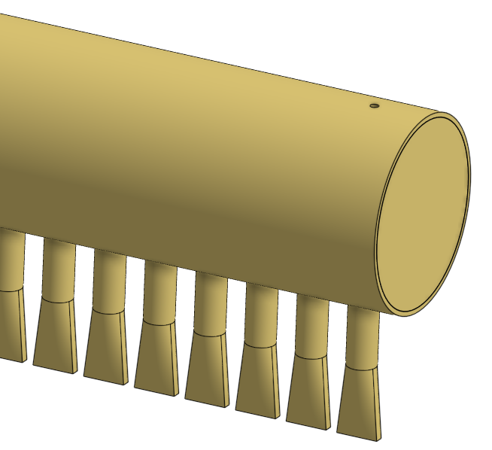
25
18
Notes:
inlet_collector
https://cad.onshape.com/documents/cb29fe9215c63d736a37e7fb/w/be3111351864b8cc004d74df/e/d03127af1390de52c6819a25?configuration=overrides%3D%257B%2B%2B%2B%2522AN%2522%253A%2B6.6885399444210005%252C%2B%2B%2B%2B%2522G_max%2522%253A%2B300%252C%2B%2B%2B%2B%2522ID_min%2522%253A%2B0.1669460459446353%252C%2B%2B%2B%2B%2522ND_hyd%2522%253A%2B8%252C%2B%2B%2B%2B%2522ND_min%2522%253A%2B3%252C%2B%2B%2B%2B%2522Q_pi%2522%253A%2B1%252C%2B%2B%2B%2B%2522Qm_max%2522%253A%2B4%252C%2B%2B%2B%2B%2522TEMP_max%2522%253A%2B30%252C%2B%2B%2B%2B%2522TEMP_min%2522%253A%2B5%252C%2B%2B%2B%2B%2522bayL%2522%253A%2B3.74%252C%2B%2B%2B%2B%2522diffuser%2522%253A%2B%257B%2B%2B%2B%2B%2B%2522B%2522%253A%2B0.06%252C%2B%2B%2B%2B%2B%2B%2522G_jet%2522%253A%2B218.31252075299807%252C%2B%2B%2B%2B%2B%2B%2522G_max%2522%253A%2B300%252C%2B%2B%2B%2B%2B%2B%2522HD_pi%2522%253A%2B5%252C%2B%2B%2B%2B%2B%2B%2522HL%2522%253A%2B0.0016286223646203382%252C%2B%2B%2B%2B%2B%2B%2522HL_max%2522%253A%2B0.0016286223646203382%252C%2B%2B%2B%2B%2B%2B%2522ND%2522%253A%2B1%252C%2B%2B%2B%2B%2B%2B%2522Q_pi%2522%253A%2B1%252C%2B%2B%2B%2B%2B%2B%2522Qm_max%2522%253A%2B4%252C%2B%2B%2B%2B%2B%2B%2522SDR%2522%253A%2B26%252C%2B%2B%2B%2B%2B%2B%2522TEMP_max%2522%253A%2B30%252C%2B%2B%2B%2B%2B%2B%2522Tm_min%2522%253A%2B1%252C%2B%2B%2B%2B%2B%2B%2522V_max%2522%253A%2B0.17872509343684248%252C%2B%2B%2B%2B%2B%2B%2522bayL%2522%253A%2B3.74%252C%2B%2B%2B%2B%2B%2B%2522diffuserL%2522%253A%2B0.1538653846%252C%2B%2B%2B%2B%2B%2B%2522done%2522%253A%2B%2B%2B%2B%2B%2Btrue%252C%2B%2B%2B%2B%2B%2B%2522ip%2522%253A%2B%2B%2B%2B%2B%2B%2522APP%2522%252C%2B%2B%2B%2B%2B%2B%2522loftAN%2522%253A%2B5%252C%2B%2B%2B%2B%2B%2B%2522loftH%2522%253A%2B0.07999191283437192%252C%2B%2B%2B%2B%2B%2B%2522loftL%2522%253A%2B0.006998385546761406%252C%2B%2B%2B%2B%2B%2B%2522pipe%2522%253A%2B%257B%2B%2B%2B%2B%2B%2B%2B%2522ID%2522%253A%2B0.03077307692%252C%2B%2B%2B%2B%2B%2B%2B%2B%2522OD%2522%253A%2B0.0333375%252C%2B%2B%2B%2B%2B%2B%2B%2B%2522T%2522%253A%2B0.001282211538%2B%2B%2B%2B%2B%257D%252C%2B%2B%2B%2B%2B%2B%2522reducedD_pi%2522%253A%2B0.962121%252C%2B%2B%2B%2B%2B%2B%2522reducedH%2522%253A%2B0.018%252C%2B%2B%2B%2B%2B%2B%2522reducedOD%2522%253A%2B0.0320747088375%252C%2B%2B%2B%2B%2B%2B%2522reverserJetS_min%2522%253A%2B0.005104833141183866%252C%2B%2B%2B%2B%2B%2B%2522reverserJetV_max%2522%253A%2B0.2095110039834734%252C%2B%2B%2B%2B%2B%2B%2522roundDiffuserV_min%2522%253A%2B0.08627955834916864%252C%2B%2B%2B%2B%2B%2B%2522slotL%2522%253A%2B0.045234559809124095%252C%2B%2B%2B%2B%2B%2B%2522slotOL%2522%253A%2B0.04733427109352281%252C%2B%2B%2B%2B%2B%2B%2522slotOW%2522%253A%2B0.010268793705454545%252C%2B%2B%2B%2B%2B%2B%2522slotW%2522%253A%2B0.0079375%252C%2B%2B%2B%2B%2B%2B%2522slotW_min%2522%253A%2B0.003175%252C%2B%2B%2B%2B%2B%2B%2522stretchL_pi%2522%253A%2B1.1%2B%2B%2B%257D%252C%2B%2B%2B%2B%2522done%2522%253A%2B%2B%2B%2Btrue%252C%2B%2B%2B%2B%2522equalizerInsert%2522%253A%2B%2B%2B%2Bfalse%252C%2B%2B%2B%2B%2522flowEqualizer%2522%253A%2B%257B%2B%2B%2B%2B%2B%2522G_max%2522%253A%2B300%252C%2B%2B%2B%2B%2B%2B%2522NU%2522%253A%2B8.006753251295927e-7%252C%2B%2B%2B%2B%2B%2B%2522Q_pi%2522%253A%2B1%252C%2B%2B%2B%2B%2B%2B%2522Qm_max%2522%253A%2B4%252C%2B%2B%2B%2B%2B%2B%2522TEMP_max%2522%253A%2B30%252C%2B%2B%2B%2B%2B%2B%2522Tm_min%2522%253A%2B3%252C%2B%2B%2B%2B%2B%2B%2522bayL%2522%253A%2B3.7100000000000004%252C%2B%2B%2B%2B%2B%2B%2522divider%2522%253A%2B%257B%2B%2B%2B%2B%2B%2B%2B%2522L%2522%253A%2B3.7052370000000003%252C%2B%2B%2B%2B%2B%2B%2B%2B%2522T%2522%253A%2B0.003175%252C%2B%2B%2B%2B%2B%2B%2B%2B%2522T_min%2522%253A%2B0.003%252C%2B%2B%2B%2B%2B%2B%2B%2B%2522centerOffsetL%2522%253A%2B-0.03937422992321121%252C%2B%2B%2B%2B%2B%2B%2B%2B%2522chordL%2522%253A%2B0.13935549066039676%252C%2B%2B%2B%2B%2B%2B%2B%2B%2522depthH%2522%253A%2B0.11940746162321121%2B%2B%2B%2B%2B%257D%252C%2B%2B%2B%2B%2B%2B%2522done%2522%253A%2B%2B%2B%2B%2B%2Btrue%252C%2B%2B%2B%2B%2B%2B%2522equalizer%2522%253A%2B%257B%2B%2B%2B%2B%2B%2B%2B%2522ED%2522%253A%2B0.012258493293554032%252C%2B%2B%2B%2B%2B%2B%2B%2B%2522G_ave%2522%253A%2B123.73436232446714%252C%2B%2B%2B%2B%2B%2B%2B%2B%2522VOL%2522%253A%2B0.014931192190821344%2B%2B%2B%2B%2B%257D%252C%2B%2B%2B%2B%2B%2B%2522gapS%2522%253A%2B0.02%252C%2B%2B%2B%2B%2B%2B%2522inletManifold%2522%253A%2B%257B%2B%2B%2B%2B%2B%2B%2B%2522A%2522%253A%2B0.016098320421370726%252C%2B%2B%2B%2B%2B%2B%2B%2B%2522ND%2522%253A%2B6%252C%2B%2B%2B%2B%2B%2B%2B%2B%2522SDR%2522%253A%2B41%252C%2B%2B%2B%2B%2B%2B%2B%2B%2522V%2522%253A%2B0.2484731260964311%252C%2B%2B%2B%2B%2B%2B%2B%2B%2522pipe%2522%253A%2B%257B%2B%2B%2B%2B%2B%2B%2B%2B%2B%2522ID%2522%253A%2B0.1600664634%252C%2B%2B%2B%2B%2B%2B%2B%2B%2B%2B%2522OD%2522%253A%2B0.168275%252C%2B%2B%2B%2B%2B%2B%2B%2B%2B%2B%2522T%2522%253A%2B0.004104268293%2B%2B%2B%2B%2B%2B%2B%257D%2B%2B%2B%2B%2B%257D%252C%2B%2B%2B%2B%2B%2B%2522ip%2522%253A%2B%2B%2B%2B%2B%2B%2522APP%2522%252C%2B%2B%2B%2B%2B%2B%2522manPipeA_pi%2522%253A%2B0.8%252C%2B%2B%2B%2B%2B%2B%2522port%2522%253A%2B%257B%2B%2B%2B%2B%2B%2B%2B%2522AN%2522%253A%2B3.2578353797327746%252C%2B%2B%2B%2B%2B%2B%2B%2B%2522B%2522%253A%2B0.7420000000000001%252C%2B%2B%2B%2B%2B%2B%2B%2B%2522B_max%2522%253A%2B0.7537996809273139%252C%2B%2B%2B%2B%2B%2B%2B%2B%2522D_min%2522%253A%2B0.07354015229691%252C%2B%2B%2B%2B%2B%2B%2B%2B%2522G_max%2522%253A%2B259.6498819009981%252C%2B%2B%2B%2B%2B%2B%2B%2B%2522L%2522%253A%2B0.7220000000000001%252C%2B%2B%2B%2B%2B%2B%2B%2B%2522Lr_pi%2522%253A%2B10%252C%2B%2B%2B%2B%2B%2B%2B%2B%2522N%2522%253A%2B5%252C%2B%2B%2B%2B%2B%2B%2B%2B%2522ND%2522%253A%2B3%252C%2B%2B%2B%2B%2B%2B%2B%2B%2522Q%2522%253A%2B0.0008%252C%2B%2B%2B%2B%2B%2B%2B%2B%2522S%2522%253A%2B0.05%252C%2B%2B%2B%2B%2B%2B%2B%2B%2522SDR%2522%253A%2B26%252C%2B%2B%2B%2B%2B%2B%2B%2B%2522V%2522%253A%2B0.30251770141261963%252C%2B%2B%2B%2B%2B%2B%2B%2B%2522pipe%2522%253A%2B%257B%2B%2B%2B%2B%2B%2B%2B%2B%2B%2522ID%2522%253A%2B0.08206153846%252C%2B%2B%2B%2B%2B%2B%2B%2B%2B%2B%2522OD%2522%253A%2B0.0889%252C%2B%2B%2B%2B%2B%2B%2B%2B%2B%2B%2522T%2522%253A%2B0.003419230769%2B%2B%2B%2B%2B%2B%2B%257D%2B%2B%2B%2B%2B%257D%252C%2B%2B%2B%2B%2B%2B%2522portReverser%2522%253A%2B%257B%2B%2B%2B%2B%2B%2B%2B%2522ND%2522%253A%2B3%252C%2B%2B%2B%2B%2B%2B%2B%2B%2522SDR%2522%253A%2B26%252C%2B%2B%2B%2B%2B%2B%2B%2B%2522pipe%2522%253A%2B%257B%2B%2B%2B%2B%2B%2B%2B%2B%2B%2522ID%2522%253A%2B0.08206153846%252C%2B%2B%2B%2B%2B%2B%2B%2B%2B%2B%2522OD%2522%253A%2B0.0889%252C%2B%2B%2B%2B%2B%2B%2B%2B%2B%2B%2522T%2522%253A%2B0.003419230769%2B%2B%2B%2B%2B%2B%2B%257D%2B%2B%2B%2B%2B%257D%252C%2B%2B%2B%2B%2B%2B%2522rep%2522%253A%2B%2B%2B%2B%2B%2Btrue%2B%2B%2B%257D%252C%2B%2B%2B%2B%2522gapS%2522%253A%2B0.01%252C%2B%2B%2B%2B%2522inletManifoldTm_min%2522%253A%2B2%252C%2B%2B%2B%2B%2522ip%2522%253A%2B%2B%2B%2B%2522APP%2522%252C%2B%2B%2B%2B%2522manifold%2522%253A%2B%257B%2B%2B%2B%2B%2B%2522HL%2522%253A%2B0.0019768260477120315%252C%2B%2B%2B%2B%2B%2B%2522HL_max%2522%253A%2B0.002444350152408703%252C%2B%2B%2B%2B%2B%2B%2522ID_min%2522%253A%2B0.18075353103239006%252C%2B%2B%2B%2B%2B%2B%2522ND%2522%253A%2B8%252C%2B%2B%2B%2B%2B%2B%2522Q_pi%2522%253A%2B1%252C%2B%2B%2B%2B%2B%2B%2522Qm_max%2522%253A%2B4%252C%2B%2B%2B%2B%2B%2B%2522SDR%2522%253A%2B41%252C%2B%2B%2B%2B%2B%2B%2522TEMP_min%2522%253A%2B5%252C%2B%2B%2B%2B%2B%2B%2522Tm_min%2522%253A%2B2%252C%2B%2B%2B%2B%2B%2B%2522V_max%2522%253A%2B0.15588220124226043%252C%2B%2B%2B%2B%2B%2B%2522activeL%2522%253A%2B3.74%252C%2B%2B%2B%2B%2B%2B%2522bandCoupling%2522%253A%2B%257B%2B%2B%2B%2B%2B%2B%2B%2522D%2522%253A%2B0.21948099999999998%252C%2B%2B%2B%2B%2B%2B%2B%2B%2522T%2522%253A%2B0.0002%252C%2B%2B%2B%2B%2B%2B%2B%2B%2522W_min%2522%253A%2B0.04%252C%2B%2B%2B%2B%2B%2B%2B%2B%2522bodyT%2522%253A%2B0.002%252C%2B%2B%2B%2B%2B%2B%2B%2B%2522clamp%2522%253A%2B%257B%2B%2B%2B%2B%2B%2B%2B%2B%2B%2522S%2522%253A%2B0.02%252C%2B%2B%2B%2B%2B%2B%2B%2B%2B%2B%2522clamp%2522%253A%2B%257B%2B%2B%2B%2B%2B%2B%2B%2B%2B%2B%2B%2522D%2522%253A%2B0.21948099999999998%252C%2B%2B%2B%2B%2B%2B%2B%2B%2B%2B%2B%2B%2522D_max%2522%253A%2B0.254%252C%2B%2B%2B%2B%2B%2B%2B%2B%2B%2B%2B%2B%2522D_min%2522%253A%2B0.181%252C%2B%2B%2B%2B%2B%2B%2B%2B%2B%2B%2B%2B%2522T%2522%253A%2B0.0005842%252C%2B%2B%2B%2B%2B%2B%2B%2B%2B%2B%2B%2B%2522W%2522%253A%2B0.0142875%252C%2B%2B%2B%2B%2B%2B%2B%2B%2B%2B%2B%2B%2522bodyT%2522%253A%2B0.002%252C%2B%2B%2B%2B%2B%2B%2B%2B%2B%2B%2B%2B%2522color%2522%253A%2B%257B%2B%2B%2B%2B%2B%2B%2B%2B%2B%2B%2B%2B%2B%2522alpha%2522%253A%2B1%252C%2B%2B%2B%2B%2B%2B%2B%2B%2B%2B%2B%2B%2B%2B%2522blue%2522%253A%2B0.85%252C%2B%2B%2B%2B%2B%2B%2B%2B%2B%2B%2B%2B%2B%2B%2522green%2522%253A%2B0.85%252C%2B%2B%2B%2B%2B%2B%2B%2B%2B%2B%2B%2B%2B%2B%2522red%2522%253A%2B0.85%2B%2B%2B%2B%2B%2B%2B%2B%2B%2B%2B%257D%252C%2B%2B%2B%2B%2B%2B%2B%2B%2B%2B%2B%2B%2522costBasis%2522%253A%2B0%252C%2B%2B%2B%2B%2B%2B%2B%2B%2B%2B%2B%2B%2522factoryL%2522%253A%2B0%252C%2B%2B%2B%2B%2B%2B%2B%2B%2B%2B%2B%2B%2522hexW%2522%253A%2B0.0079375%252C%2B%2B%2B%2B%2B%2B%2B%2B%2B%2B%2B%2B%2522hoseClampType%2522%253A%2B%2B%2B%2B%2B%2B%2B%2B%2B%2B%2B%2B%2522HOSE_CLAMP%2522%252C%2B%2B%2B%2B%2B%2B%2B%2B%2B%2B%2B%2B%2522id%2522%253A%2B%2B%2B%2B%2B%2B%2B%2B%2B%2B%2B%2B%2522MMC%253A5011T43%2522%252C%2B%2B%2B%2B%2B%2B%2B%2B%2B%2B%2B%2B%2522implementationPartner%2522%253A%2B%2B%2B%2B%2B%2B%2B%2B%2B%2B%2B%2B%2522GENERIC%2522%252C%2B%2B%2B%2B%2B%2B%2B%2B%2B%2B%2B%2B%2522material%2522%253A%2B%2B%2B%2B%2B%2B%2B%2B%2B%2B%2B%2B%2522STAINLESS_STEEL%2522%252C%2B%2B%2B%2B%2B%2B%2B%2B%2B%2B%2B%2B%2522name%2522%253A%2B%2B%2B%2B%2B%2B%2B%2B%2B%2B%2B%2B%2522SS316%2Bhose_clamp%2522%252C%2B%2B%2B%2B%2B%2B%2B%2B%2B%2B%2B%2B%2522pn%2522%253A%2B%2B%2B%2B%2B%2B%2B%2B%2B%2B%2B%2B%25225011T43%2522%252C%2B%2B%2B%2B%2B%2B%2B%2B%2B%2B%2B%2B%2522stainlessSteelGrade%2522%253A%2B%2B%2B%2B%2B%2B%2B%2B%2B%2B%2B%2B%2522SS316%2522%252C%2B%2B%2B%2B%2B%2B%2B%2B%2B%2B%2B%2B%2522unitCost%2522%253A%2B4.815%252C%2B%2B%2B%2B%2B%2B%2B%2B%2B%2B%2B%2B%2522vendor%2522%253A%2B%2B%2B%2B%2B%2B%2B%2B%2B%2B%2B%2B%2522MMC%2522%2B%2B%2B%2B%2B%2B%2B%2B%2B%257D%252C%2B%2B%2B%2B%2B%2B%2B%2B%2B%2B%2522ip%2522%253A%2B%2B%2B%2B%2B%2B%2B%2B%2B%2B%2522APP%2522%2B%2B%2B%2B%2B%2B%2B%257D%252C%2B%2B%2B%2B%2B%2B%2B%2B%2522done%2522%253A%2B%2B%2B%2B%2B%2B%2B%2Btrue%252C%2B%2B%2B%2B%2B%2B%2B%2B%2522flexBand%2522%253A%2B%257B%2B%2B%2B%2B%2B%2B%2B%2B%2B%2522H%2522%253A%2B0%252C%2B%2B%2B%2B%2B%2B%2B%2B%2B%2B%2522HW%2522%253A%2B0%252C%2B%2B%2B%2B%2B%2B%2B%2B%2B%2B%2522L%2522%253A%2B0.7584718869227955%252C%2B%2B%2B%2B%2B%2B%2B%2B%2B%2B%2522OD%2522%253A%2B0.21988699999999997%252C%2B%2B%2B%2B%2B%2B%2B%2B%2B%2B%2522W%2522%253A%2B0.04%252C%2B%2B%2B%2B%2B%2B%2B%2B%2B%2B%2522col%2522%253A%2B%2B%2B%2B%2B%2B%2B%2B%2B%2Bfalse%252C%2B%2B%2B%2B%2B%2B%2B%2B%2B%2B%2522color%2522%253A%2B%257B%2B%2B%2B%2B%2B%2B%2B%2B%2B%2B%2B%2522alpha%2522%253A%2B1%252C%2B%2B%2B%2B%2B%2B%2B%2B%2B%2B%2B%2B%2522blue%2522%253A%2B0.85%252C%2B%2B%2B%2B%2B%2B%2B%2B%2B%2B%2B%2B%2522green%2522%253A%2B0.85%252C%2B%2B%2B%2B%2B%2B%2B%2B%2B%2B%2B%2B%2522red%2522%253A%2B0.85%2B%2B%2B%2B%2B%2B%2B%2B%2B%257D%252C%2B%2B%2B%2B%2B%2B%2B%2B%2B%2B%2522costBasis%2522%253A%2B2%252C%2B%2B%2B%2B%2B%2B%2B%2B%2B%2B%2522factoryL%2522%253A%2B2.54%252C%2B%2B%2B%2B%2B%2B%2B%2B%2B%2B%2522factoryT%2522%253A%2B0.000203%252C%2B%2B%2B%2B%2B%2B%2B%2B%2B%2B%2522factoryW%2522%253A%2B0.1524%252C%2B%2B%2B%2B%2B%2B%2B%2B%2B%2B%2522id%2522%253A%2B%2B%2B%2B%2B%2B%2B%2B%2B%2B%2522MMC%253A9548K256%2522%252C%2B%2B%2B%2B%2B%2B%2B%2B%2B%2B%2522implementationPartner%2522%253A%2B%2B%2B%2B%2B%2B%2B%2B%2B%2B%2522GENERIC%2522%252C%2B%2B%2B%2B%2B%2B%2B%2B%2B%2B%2522ip%2522%253A%2B%2B%2B%2B%2B%2B%2B%2B%2B%2B%2522APP%2522%252C%2B%2B%2B%2B%2B%2B%2B%2B%2B%2B%2522material%2522%253A%2B%2B%2B%2B%2B%2B%2B%2B%2B%2B%2522STAINLESS_STEEL%2522%252C%2B%2B%2B%2B%2B%2B%2B%2B%2B%2B%2522name%2522%253A%2B%2B%2B%2B%2B%2B%2B%2B%2B%2B%25220.2032%2Bmm%2B316%2Bstainless%2Bsteel%2Bsheet%2522%252C%2B%2B%2B%2B%2B%2B%2B%2B%2B%2B%2522pn%2522%253A%2B%2B%2B%2B%2B%2B%2B%2B%2B%2B%25229548K256%2522%252C%2B%2B%2B%2B%2B%2B%2B%2B%2B%2B%2522sheetMaterial%2522%253A%2B%2B%2B%2B%2B%2B%2B%2B%2B%2B%2522STAINLESS_STEEL%2522%252C%2B%2B%2B%2B%2B%2B%2B%2B%2B%2B%2522sheetType%2522%253A%2B%2B%2B%2B%2B%2B%2B%2B%2B%2B%2522SHEET%2522%252C%2B%2B%2B%2B%2B%2B%2B%2B%2B%2B%2522unitCost%2522%253A%2B208.4%252C%2B%2B%2B%2B%2B%2B%2B%2B%2B%2B%2522vendor%2522%253A%2B%2B%2B%2B%2B%2B%2B%2B%2B%2B%2522MMC%2522%2B%2B%2B%2B%2B%2B%2B%257D%252C%2B%2B%2B%2B%2B%2B%2B%2B%2522gapS%2522%253A%2B0.0017125000000000022%252C%2B%2B%2B%2B%2B%2B%2B%2B%2522ip%2522%253A%2B%2B%2B%2B%2B%2B%2B%2B%2522APP%2522%252C%2B%2B%2B%2B%2B%2B%2B%2B%2522pipeOD%2522%253A%2B0.219075%252C%2B%2B%2B%2B%2B%2B%2B%2B%2522shearA%2522%253A%2B0.00013984307724045414%252C%2B%2B%2B%2B%2B%2B%2B%2B%2522shearF%2522%253A%2B58734.09244099074%252C%2B%2B%2B%2B%2B%2B%2B%2B%2522shearStrengthP%2522%253A%2B4.2e%252B8%252C%2B%2B%2B%2B%2B%2B%2B%2B%2522tensileP%2522%253A%2B7e%252B8%2B%2B%2B%2B%2B%257D%252C%2B%2B%2B%2B%2B%2B%2522bandW%2522%253A%2B0.04%252C%2B%2B%2B%2B%2B%2B%2522bayL%2522%253A%2B3.74%252C%2B%2B%2B%2B%2B%2B%2522coupling%2522%253A%2B%257B%2B%2B%2B%2B%2B%2B%2B%2522ND%2522%253A%2B8%252C%2B%2B%2B%2B%2B%2B%2B%2B%2522OD%2522%253A%2B0.237331%252C%2B%2B%2B%2B%2B%2B%2B%2B%2522axisL%2522%253A%2B0.114697%252C%2B%2B%2B%2B%2B%2B%2B%2B%2522socketID%2522%253A%2B0.219075%252C%2B%2B%2B%2B%2B%2B%2B%2B%2522socketL%2522%253A%2B0.1143%2B%2B%2B%2B%2B%257D%252C%2B%2B%2B%2B%2B%2B%2522diffuser%2522%253A%2B%2B%2B%2B%2B%2Btrue%252C%2B%2B%2B%2B%2B%2B%2522done%2522%253A%2B%2B%2B%2B%2B%2Btrue%252C%2B%2B%2B%2B%2B%2B%2522endBlankL%2522%253A%2B0.04%252C%2B%2B%2B%2B%2B%2B%2522endBlankL_min%2522%253A%2B0%252C%2B%2B%2B%2B%2B%2B%2522gapS%2522%253A%2B0.01%252C%2B%2B%2B%2B%2B%2B%2522ip%2522%253A%2B%2B%2B%2B%2B%2B%2522APP%2522%252C%2B%2B%2B%2B%2B%2B%2522manifoldND%2522%253A%2B8%252C%2B%2B%2B%2B%2B%2B%2522manifoldPortQ_pi%2522%253A%2B0.67%252C%2B%2B%2B%2B%2B%2B%2522orificeB%2522%253A%2B0.06%252C%2B%2B%2B%2B%2B%2B%2522orificeD%2522%253A%2B0.0320747088375%252C%2B%2B%2B%2B%2B%2B%2522orificeN%2522%253A%2B61%252C%2B%2B%2B%2B%2B%2B%2522orificeStartB%2522%253A%2B0.06500000000000038%252C%2B%2B%2B%2B%2B%2B%2522orificeZoneL%2522%253A%2B3.6179252911625004%252C%2B%2B%2B%2B%2B%2B%2522pipe%2522%253A%2B%257B%2B%2B%2B%2B%2B%2B%2B%2522ID%2522%253A%2B0.2083884146%252C%2B%2B%2B%2B%2B%2B%2B%2B%2522OD%2522%253A%2B0.219075%252C%2B%2B%2B%2B%2B%2B%2B%2B%2522T%2522%253A%2B0.005343292683%2B%2B%2B%2B%2B%257D%252C%2B%2B%2B%2B%2B%2B%2522pipeHL%2522%253A%2B0.0003482036830916935%252C%2B%2B%2B%2B%2B%2B%2522pipeHL_max%2522%253A%2B0.0008157277877883646%252C%2B%2B%2B%2B%2B%2B%2522pipeL%2522%253A%2B3.7100000000000004%252C%2B%2B%2B%2B%2B%2B%2522portHL%2522%253A%2B0.0016286223646203382%252C%2B%2B%2B%2B%2B%2B%2522rep%2522%253A%2B%2B%2B%2B%2B%2Btrue%252C%2B%2B%2B%2B%2B%2B%2522stubL%2522%253A%2B0.13469699999999998%252C%2B%2B%2B%2B%2B%2B%2522useND%2522%253A%2B%2B%2B%2B%2B%2Btrue%252C%2B%2B%2B%2B%2B%2B%2522ventD%2522%253A%2B0.009525%252C%2B%2B%2B%2B%2B%2B%2522ventL%2522%253A%2B0.05%2B%2B%2B%257D%252C%2B%2B%2B%2B%2522manifoldPortQ_pi%2522%253A%2B0.67%252C%2B%2B%2B%2B%2522manifoldV_max%2522%253A%2B0.18273335801590063%252C%2B%2B%2B%2B%2522rep%2522%253A%2B%2B%2B%2Btrue%252C%2B%2B%2B%2B%2522revID%2522%253A%2B0.08206153846%252C%2B%2B%2B%2B%2522revManB%2522%253A%2B0.2716101555198444%252C%2B%2B%2B%2B%2522sedRevToDiffuserS%2522%253A%2B0.01%2B%257D&renderMode=0&uiState=66b8afde5a9efd706c4021fb

Slide 21
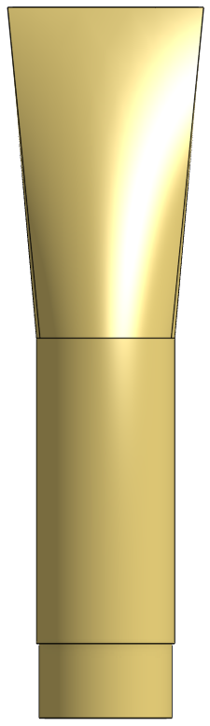
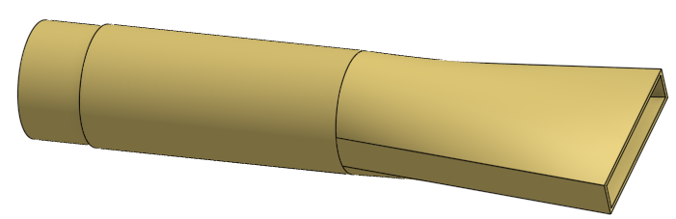
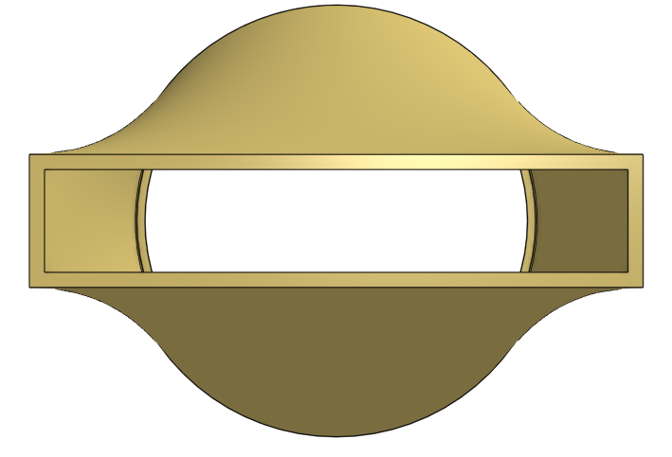
Notes:
https://cad.onshape.com/documents/cb29fe9215c63d736a37e7fb/w/be3111351864b8cc004d74df/e/4441759c4e6d7e0bf3ad526b?configuration=overrides%3D%257B%2B%2B%2B%2522B%2522%253A%2B0.06%252C%2B%2B%2B%2B%2522G_jet%2522%253A%2B218.31252075299807%252C%2B%2B%2B%2B%2522G_max%2522%253A%2B300%252C%2B%2B%2B%2B%2522HD_pi%2522%253A%2B5%252C%2B%2B%2B%2B%2522HL%2522%253A%2B0.0016286223646203382%252C%2B%2B%2B%2B%2522HL_max%2522%253A%2B0.0016286223646203382%252C%2B%2B%2B%2B%2522ND%2522%253A%2B1%252C%2B%2B%2B%2B%2522Q_pi%2522%253A%2B1%252C%2B%2B%2B%2B%2522Qm_max%2522%253A%2B4%252C%2B%2B%2B%2B%2522SDR%2522%253A%2B26%252C%2B%2B%2B%2B%2522TEMP_max%2522%253A%2B30%252C%2B%2B%2B%2B%2522Tm_min%2522%253A%2B1%252C%2B%2B%2B%2B%2522V_max%2522%253A%2B0.17872509343684248%252C%2B%2B%2B%2B%2522bayL%2522%253A%2B3.74%252C%2B%2B%2B%2B%2522diffuserL%2522%253A%2B0.1538653846%252C%2B%2B%2B%2B%2522done%2522%253A%2B%2B%2B%2Btrue%252C%2B%2B%2B%2B%2522ip%2522%253A%2B%2B%2B%2B%2522APP%2522%252C%2B%2B%2B%2B%2522loftAN%2522%253A%2B5%252C%2B%2B%2B%2B%2522loftH%2522%253A%2B0.07999191283437192%252C%2B%2B%2B%2B%2522loftL%2522%253A%2B0.006998385546761406%252C%2B%2B%2B%2B%2522pipe%2522%253A%2B%257B%2B%2B%2B%2B%2B%2522ID%2522%253A%2B0.03077307692%252C%2B%2B%2B%2B%2B%2B%2522OD%2522%253A%2B0.0333375%252C%2B%2B%2B%2B%2B%2B%2522T%2522%253A%2B0.001282211538%2B%2B%2B%257D%252C%2B%2B%2B%2B%2522reducedD_pi%2522%253A%2B0.962121%252C%2B%2B%2B%2B%2522reducedH%2522%253A%2B0.018%252C%2B%2B%2B%2B%2522reducedOD%2522%253A%2B0.0320747088375%252C%2B%2B%2B%2B%2522reverserJetS_min%2522%253A%2B0.005104833141183866%252C%2B%2B%2B%2B%2522reverserJetV_max%2522%253A%2B0.2095110039834734%252C%2B%2B%2B%2B%2522roundDiffuserV_min%2522%253A%2B0.08627955834916864%252C%2B%2B%2B%2B%2522slotL%2522%253A%2B0.045234559809124095%252C%2B%2B%2B%2B%2522slotOL%2522%253A%2B0.04733427109352281%252C%2B%2B%2B%2B%2522slotOW%2522%253A%2B0.010268793705454545%252C%2B%2B%2B%2B%2522slotW%2522%253A%2B0.0079375%252C%2B%2B%2B%2B%2522slotW_min%2522%253A%2B0.003175%252C%2B%2B%2B%2B%2522stretchL_pi%2522%253A%2B1.1%2B%257D&renderMode=0&uiState=66b8b11a5a9efd706c4022f5

Slide 23
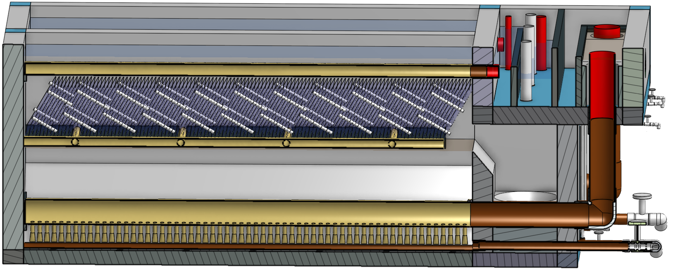

Slide 24
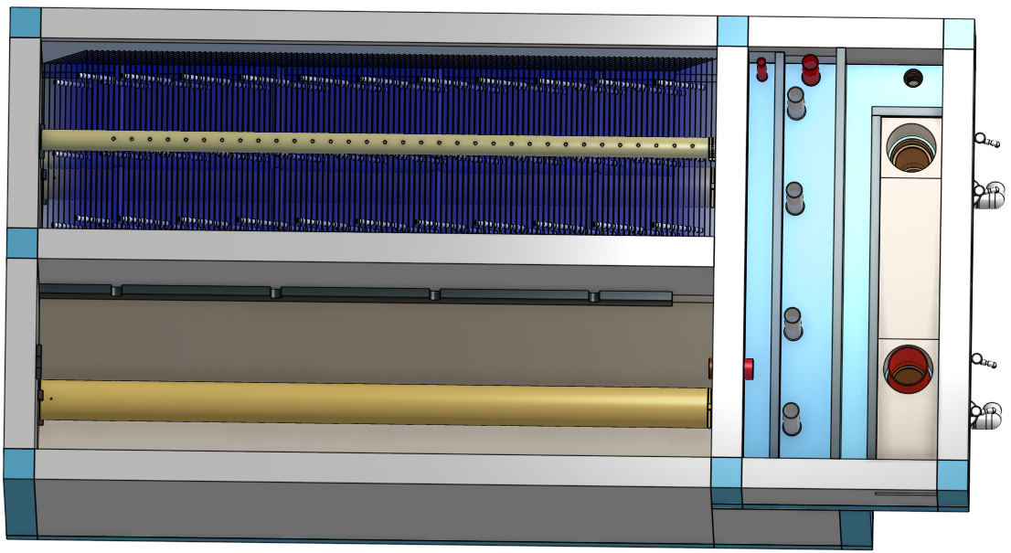
Notes:
https://cad.onshape.com/documents/cb29fe9215c63d736a37e7fb/w/be3111351864b8cc004d74df/e/2546a192555f619bb96446af?configuration=overrides%3D%257B%2522rep%2522%253Atrue%252C%2B%2522repBay%2522%253Atrue%252C%2522ipEnv%2522%253A%2522APP%2522%252C%2B%2522Qm_max%2522%253A8%252C%2B%2522spare%2522%253A0%257D%3Bplastic%3Dtrue&renderMode=0&uiState=66b8a9185a9efd706c4019d2

Slide 25
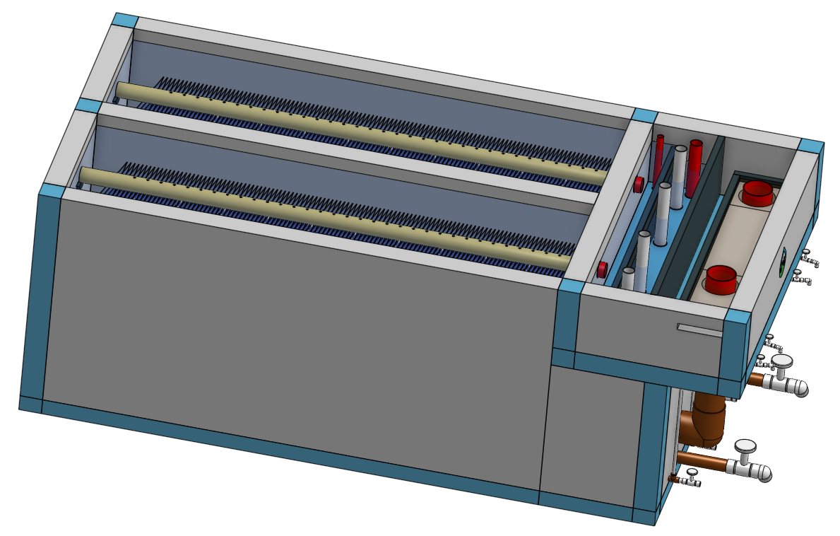
Notes:
https://cad.onshape.com/documents/cb29fe9215c63d736a37e7fb/w/be3111351864b8cc004d74df/e/2546a192555f619bb96446af?configuration=overrides%3D%257B%2522rep%2522%253Atrue%252C%2B%2522repBay%2522%253Atrue%252C%2522ipEnv%2522%253A%2522APP%2522%252C%2B%2522Qm_max%2522%253A8%252C%2B%2522spare%2522%253A0%257D%3Bplastic%3Dtrue&renderMode=0&leftPanel=false&uiState=66b8b34d5a9efd706c402ad4

Slide 26
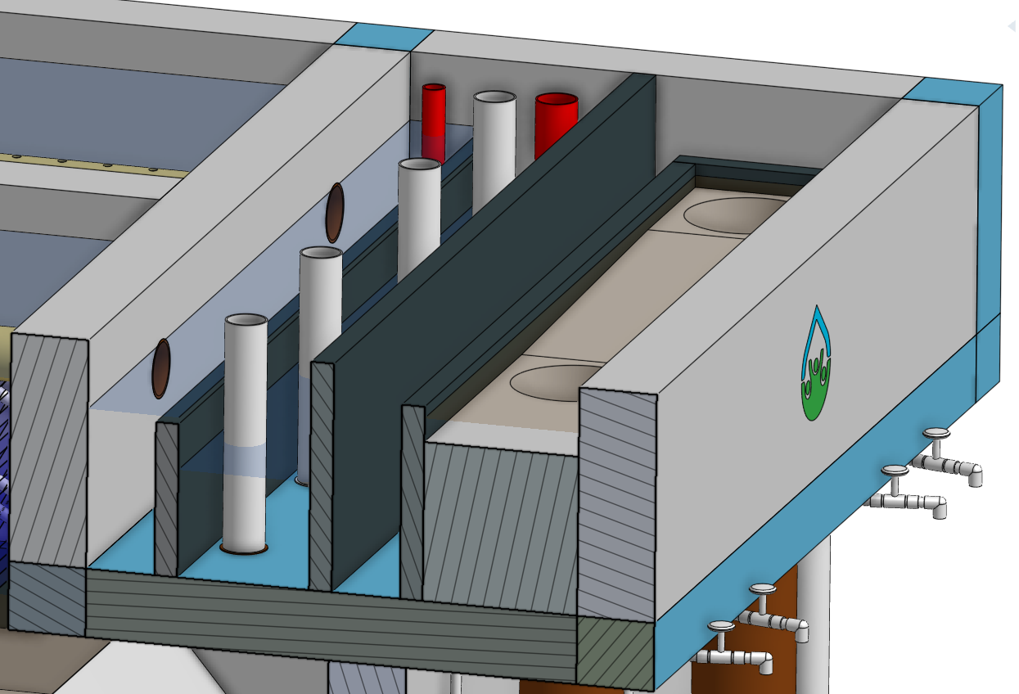
Notes:
https://cad.onshape.com/documents/cb29fe9215c63d736a37e7fb/w/be3111351864b8cc004d74df/e/2546a192555f619bb96446af?configuration=overrides%3D%257B%2522rep%2522%253Atrue%252C%2B%2522repBay%2522%253Atrue%252C%2522ipEnv%2522%253A%2522APP%2522%252C%2B%2522Qm_max%2522%253A8%252C%2B%2522spare%2522%253A0%257D%3Bplastic%3Dtrue&renderMode=0&uiState=66b8b7d75a9efd706c403a67

Slide 27
Filter

Slide 28
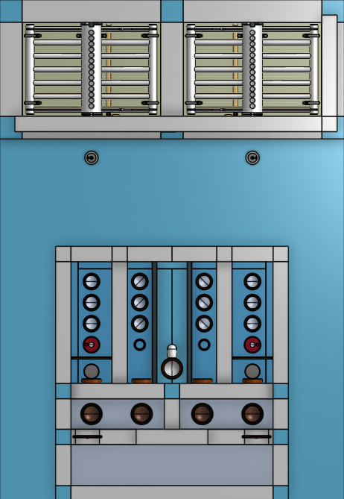
Notes:
Icons!

Slide 29
12
11
10
9
8
7
4
3
1
2
6
5
20
21
23
24
17
16
13
14
15
18
19
Notes:
filter_top
https://cad.onshape.com/documents/c23b77aaf906eccd8540b712/w/eb5b0032b53164913bb46763/e/f6e11ecbd35bec9bfa6c168c?configuration=includeRecycle%3Dfalse%3Boverrides%3D%257B%2522rep%2522%253Atrue%252C%2B%2522bwHSF%2522%253A0.1%252C%2522filterMode%2522%253Afalse%252C%2B%2522repBay%2522%253Atrue%252C%2B%2522roundLm%2522%253A10%252C%2B%2522ipEnv%2522%253A%2522APP%2522%252C%2522ipCiv%2522%253A%2522APP%2522%252C%2B%2522Qm_max%2522%253A30%252C%2B%2522fiPipes%2522%253A%257B%2522bay%2522%253A%257B%2522spare%2522%253A0%252C%2B%2522pair%2522%253Atrue%257D%257D%257D%3Bplastic%3Dtrue%3Bstairs%3Dfalse&renderMode=0&uiState=66ba4981c3d4627c4539d3ab

Slide 30
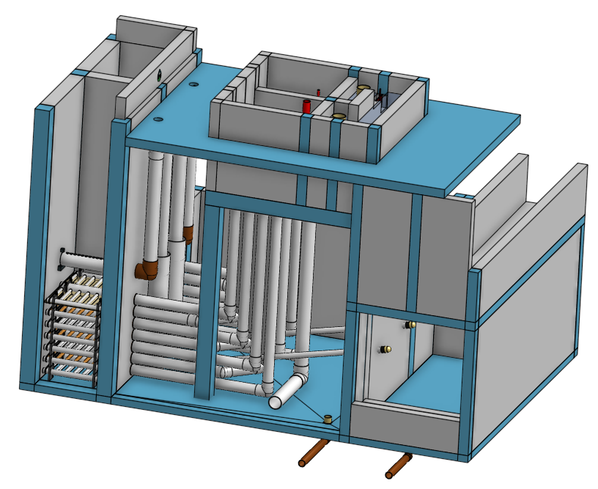
20
13
7
1
13
10
9
8
4
3
23
2
25
40
6
11
19
22
40
41
5
39
17
16
14
15
18
19
Notes:
filter_isometric
https://cad.onshape.com/documents/c23b77aaf906eccd8540b712/w/eb5b0032b53164913bb46763/e/f6e11ecbd35bec9bfa6c168c?configuration=includeRecycle%3Dfalse%3Boverrides%3D%257B%2522rep%2522%253Atrue%252C%2B%2522bwHSF%2522%253A0.1%252C%2522filterMode%2522%253Afalse%252C%2B%2522repBay%2522%253Atrue%252C%2B%2522roundLm%2522%253A10%252C%2B%2522ipEnv%2522%253A%2522APP%2522%252C%2522ipCiv%2522%253A%2522APP%2522%252C%2B%2522Qm_max%2522%253A30%252C%2B%2522fiPipes%2522%253A%257B%2522bay%2522%253A%257B%2522spare%2522%253A0%252C%2B%2522pair%2522%253Atrue%257D%257D%257D%3Bplastic%3Dtrue%3Bstairs%3Dfalse&renderMode=0&uiState=66ba4964c3d4627c4539d3a2

Slide 31
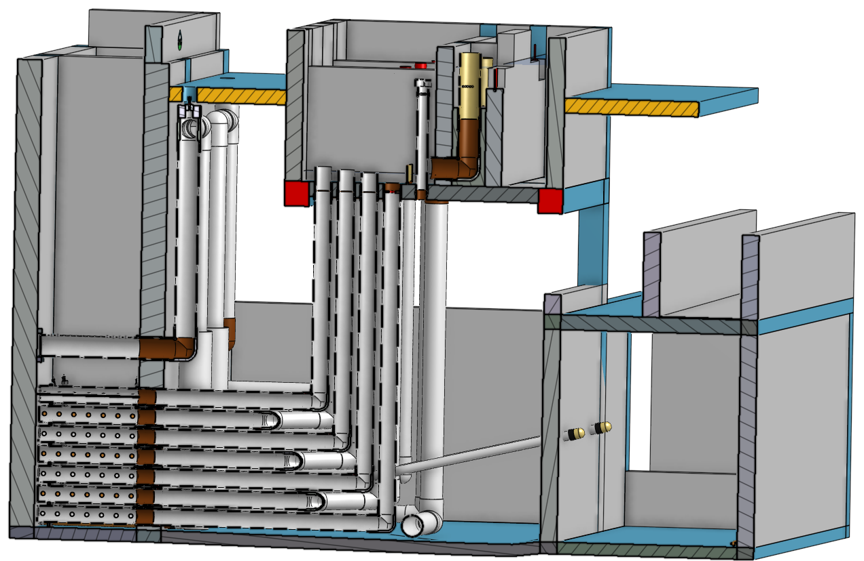
24
12
11
8
5
23
19
22
36
Notes:
filter_left_section_isometric
https://cad.onshape.com/documents/c23b77aaf906eccd8540b712/w/eb5b0032b53164913bb46763/e/f6e11ecbd35bec9bfa6c168c?configuration=includeRecycle%3Dfalse%3Boverrides%3D%257B%2522rep%2522%253Atrue%252C%2B%2522bwHSF%2522%253A0.1%252C%2522filterMode%2522%253Afalse%252C%2B%2522repBay%2522%253Atrue%252C%2B%2522roundLm%2522%253A10%252C%2B%2522ipEnv%2522%253A%2522APP%2522%252C%2522ipCiv%2522%253A%2522APP%2522%252C%2B%2522Qm_max%2522%253A30%252C%2B%2522fiPipes%2522%253A%257B%2522bay%2522%253A%257B%2522spare%2522%253A0%252C%2B%2522pair%2522%253Atrue%257D%257D%257D%3Bplastic%3Dtrue%3Bstairs%3Dfalse&renderMode=0&uiState=66ba522bc3d4627c4539eaa6

Slide 32
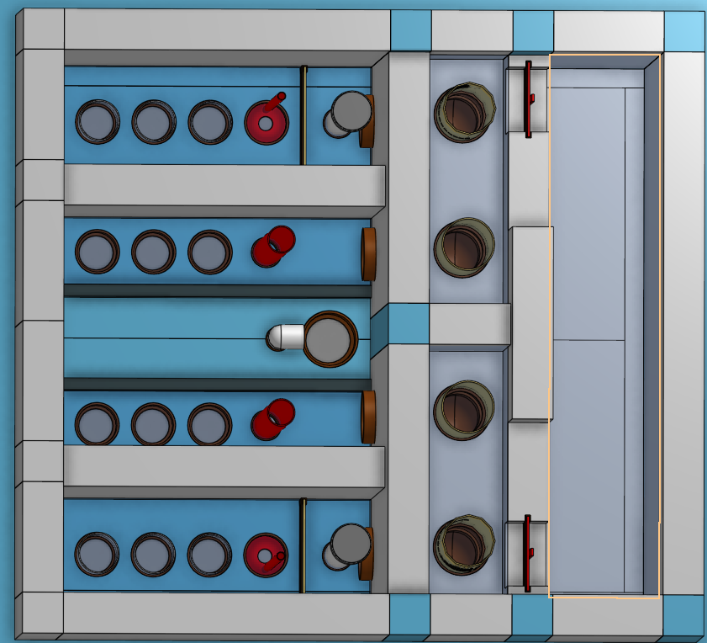
12
10
9
8
7
5
4
3
1
11
2
13
6
17
18
19
14
15
16
Notes:
filter_controls_top_isometric
https://cad.onshape.com/documents/c23b77aaf906eccd8540b712/w/eb5b0032b53164913bb46763/e/f6e11ecbd35bec9bfa6c168c?configuration=includeRecycle%3Dfalse%3Boverrides%3D%257B%2522rep%2522%253Atrue%252C%2B%2522bwHSF%2522%253A0.1%252C%2522filterMode%2522%253Afalse%252C%2B%2522repBay%2522%253Atrue%252C%2B%2522roundLm%2522%253A10%252C%2B%2522ipEnv%2522%253A%2522APP%2522%252C%2522ipCiv%2522%253A%2522APP%2522%252C%2B%2522Qm_max%2522%253A30%252C%2B%2522fiPipes%2522%253A%257B%2522bay%2522%253A%257B%2522spare%2522%253A0%252C%2B%2522pair%2522%253Atrue%257D%257D%257D%3Bplastic%3Dtrue%3Bstairs%3Dfalse&renderMode=0&uiState=66ba4a55c3d4627c4539d44e

Slide 33
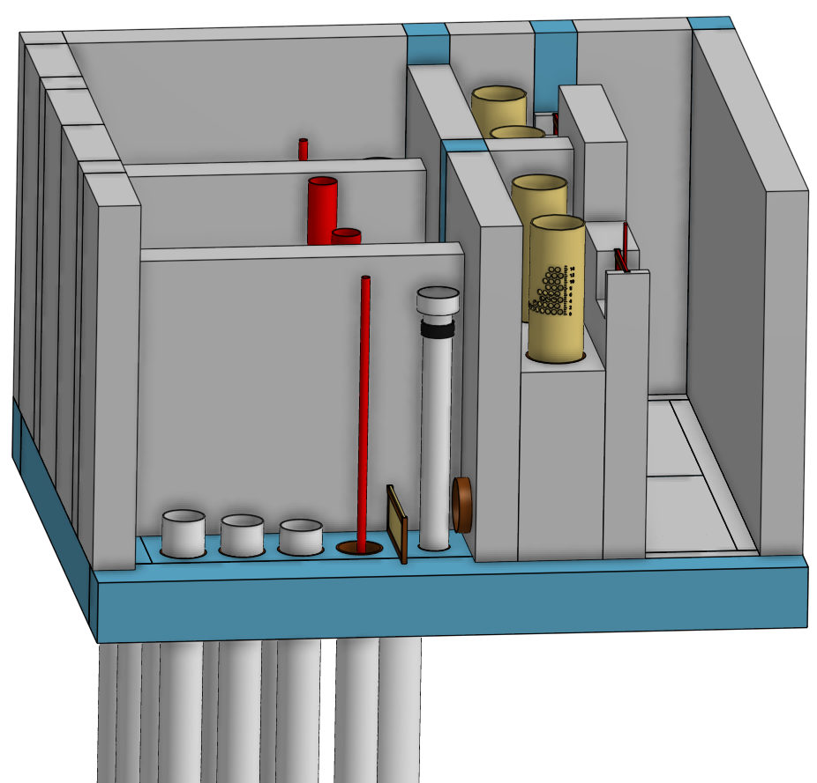
2
3
12
11
8
9
5
Notes:
filter_controls_inlet_tank
https://cad.onshape.com/documents/c23b77aaf906eccd8540b712/w/eb5b0032b53164913bb46763/e/f6e11ecbd35bec9bfa6c168c?configuration=includeRecycle%3Dfalse%3Boverrides%3D%257B%2522rep%2522%253Atrue%252C%2B%2522bwHSF%2522%253A0.1%252C%2522filterMode%2522%253Afalse%252C%2B%2522repBay%2522%253Atrue%252C%2B%2522roundLm%2522%253A10%252C%2B%2522ipEnv%2522%253A%2522APP%2522%252C%2522ipCiv%2522%253A%2522APP%2522%252C%2B%2522Qm_max%2522%253A30%252C%2B%2522fiPipes%2522%253A%257B%2522bay%2522%253A%257B%2522spare%2522%253A0%252C%2B%2522pair%2522%253Atrue%257D%257D%257D%3Bplastic%3Dtrue%3Bstairs%3Dfalse&renderMode=0&uiState=66bb66b59ecab64a720689be

Slide 34
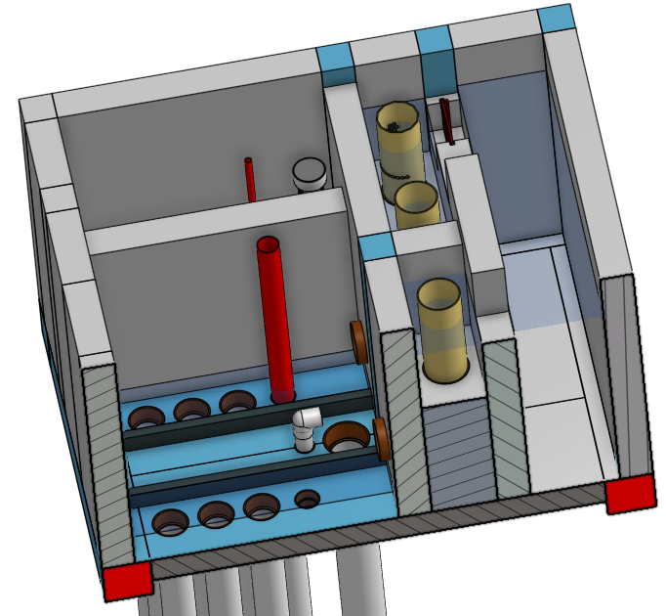
13
15
17
19
15
18
16
14
Notes:
filter_controls_outlet_tank_section
https://cad.onshape.com/documents/c23b77aaf906eccd8540b712/w/eb5b0032b53164913bb46763/e/f6e11ecbd35bec9bfa6c168c?configuration=includeRecycle%3Dfalse%3Boverrides%3D%257B%2522rep%2522%253Atrue%252C%2B%2522bwHSF%2522%253A0.1%252C%2522filterMode%2522%253Afalse%252C%2B%2522repBay%2522%253Atrue%252C%2B%2522roundLm%2522%253A10%252C%2B%2522ipEnv%2522%253A%2522APP%2522%252C%2522ipCiv%2522%253A%2522APP%2522%252C%2B%2522Qm_max%2522%253A30%252C%2B%2522fiPipes%2522%253A%257B%2522bay%2522%253A%257B%2522spare%2522%253A0%252C%2B%2522pair%2522%253Atrue%257D%257D%257D%3Bplastic%3Dtrue%3Bstairs%3Dfalse&renderMode=0&uiState=66bb67579ecab64a72068bb1

Slide 35
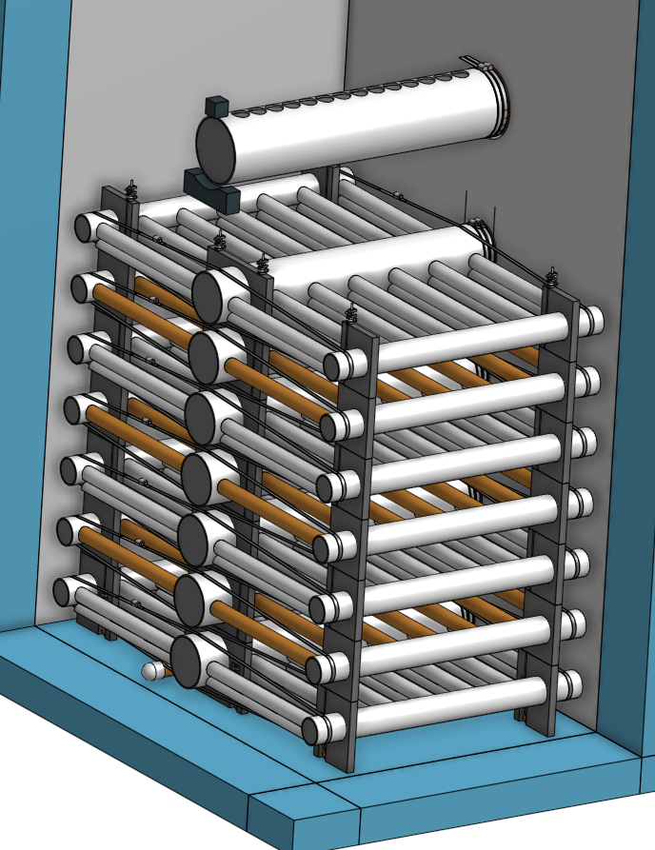
28
31
28
29
35
30
21
32
Notes:
filter_internal_piping
https://cad.onshape.com/documents/c23b77aaf906eccd8540b712/w/eb5b0032b53164913bb46763/e/cc8bb78817330923cd045be1?configuration=overrides%3D%257B%2B%2B%2B%2522bwUpliftHW_max%2522%253A%2B1.1191336200532875%252C%2B%2B%2B%2B%2522fiPipes%2522%253A%2B%257B%2B%2B%2B%2B%2B%2522band%2522%253A%2B%257B%2B%2B%2B%2B%2B%2B%2B%2522T%2522%253A%2B0.0002%252C%2B%2B%2B%2B%2B%2B%2B%2B%2522W%2522%253A%2B0.04%252C%2B%2B%2B%2B%2B%2B%2B%2B%2522W_min%2522%253A%2B0.04%2B%2B%2B%2B%2B%257D%252C%2B%2B%2B%2B%2B%2B%2522bay%2522%253A%2B%257B%2B%2B%2B%2B%2B%2B%2B%2522N%2522%253A%2B2%252C%2B%2B%2B%2B%2B%2B%2B%2B%2522Qm%2522%253A%2B15%252C%2B%2B%2B%2B%2B%2B%2B%2B%2522Qm_max%2522%253A%2B26.870791196607236%252C%2B%2B%2B%2B%2B%2B%2B%2B%2522Qm_maxbod%2522%253A%2B60%252C%2B%2B%2B%2B%2B%2B%2B%2B%2522Qm_min%2522%253A%2B8%252C%2B%2B%2B%2B%2B%2B%2B%2B%2522multiCell%2522%253A%2B%2B%2B%2B%2B%2B%2B%2Bfalse%252C%2B%2B%2B%2B%2B%2B%2B%2B%2522pair%2522%253A%2B%2B%2B%2B%2B%2B%2B%2Btrue%252C%2B%2B%2B%2B%2B%2B%2B%2B%2522pairN%2522%253A%2B1%252C%2B%2B%2B%2B%2B%2B%2B%2B%2522single%2522%253A%2B%2B%2B%2B%2B%2B%2B%2Bfalse%252C%2B%2B%2B%2B%2B%2B%2B%2B%2522spare%2522%253A%2B0%2B%2B%2B%2B%2B%257D%252C%2B%2B%2B%2B%2B%2B%2522branch%2522%253A%2B%257B%2B%2B%2B%2B%2B%2B%2B%2522B%2522%253A%2B0.15%252C%2B%2B%2B%2B%2B%2B%2B%2B%2522L%2522%253A%2B0.5569625%252C%2B%2B%2B%2B%2B%2B%2B%2B%2522L_max%2522%253A%2B1%252C%2B%2B%2B%2B%2B%2B%2B%2B%2522bwInlet%2522%253A%2B%257B%2B%2B%2B%2B%2B%2B%2B%2B%2B%2522L%2522%253A%2B0.5569625%252C%2B%2B%2B%2B%2B%2B%2B%2B%2B%2B%2522ND%2522%253A%2B1.5%252C%2B%2B%2B%2B%2B%2B%2B%2B%2B%2B%2522SDR%2522%253A%2B12.25806452%252C%2B%2B%2B%2B%2B%2B%2B%2B%2B%2B%2522Tm_min%2522%253A%2B3%252C%2B%2B%2B%2B%2B%2B%2B%2B%2B%2B%2522V_max%2522%253A%2B1.2880489886845754%252C%2B%2B%2B%2B%2B%2B%2B%2B%2B%2B%2522bwPortV%2522%253A%2B0.8534472928776022%252C%2B%2B%2B%2B%2B%2B%2B%2B%2B%2B%2522bwV%2522%253A%2B1.2880489886845754%252C%2B%2B%2B%2B%2B%2B%2B%2B%2B%2B%2522fiPortV%2522%253A%2B0.14224121547960036%252C%2B%2B%2B%2B%2B%2B%2B%2B%2B%2B%2522fiV%2522%253A%2B0.21467483144742924%252C%2B%2B%2B%2B%2B%2B%2B%2B%2B%2B%2522pipe%2522%253A%2B%257B%2B%2B%2B%2B%2B%2B%2B%2B%2B%2B%2B%2522ID%2522%253A%2B0.040386%252C%2B%2B%2B%2B%2B%2B%2B%2B%2B%2B%2B%2B%2522OD%2522%253A%2B0.04826%252C%2B%2B%2B%2B%2B%2B%2B%2B%2B%2B%2B%2B%2522T%2522%253A%2B0.003937%2B%2B%2B%2B%2B%2B%2B%2B%2B%257D%252C%2B%2B%2B%2B%2B%2B%2B%2B%2B%2B%2522portB%2522%253A%2B0.01637959524542191%252C%2B%2B%2B%2B%2B%2B%2B%2B%2B%2B%2522portD%2522%253A%2B0.008%252C%2B%2B%2B%2B%2B%2B%2B%2B%2B%2B%2522portHE%2522%253A%2B0.03713665123768605%252C%2B%2B%2B%2B%2B%2B%2B%2B%2B%2B%2522portPSI_pi%2522%253A%2B0.4390243902439023%252C%2B%2B%2B%2B%2B%2B%2B%2B%2B%2B%2522portQ_pi%2522%253A%2B0.8%2B%2B%2B%2B%2B%2B%2B%257D%252C%2B%2B%2B%2B%2B%2B%2B%2B%2522inlet%2522%253A%2B%257B%2B%2B%2B%2B%2B%2B%2B%2B%2B%2522ND%2522%253A%2B1.5%252C%2B%2B%2B%2B%2B%2B%2B%2B%2B%2B%2522SDR%2522%253A%2B12.25806452%252C%2B%2B%2B%2B%2B%2B%2B%2B%2B%2B%2522Tm_min%2522%253A%2B3%252C%2B%2B%2B%2B%2B%2B%2B%2B%2B%2B%2522V_max%2522%253A%2B0.6254641371431919%252C%2B%2B%2B%2B%2B%2B%2B%2B%2B%2B%2522inner%2522%253A%2B%257B%2B%2B%2B%2B%2B%2B%2B%2B%2B%2B%2B%2522portB%2522%253A%2B0.03730907805901659%2B%2B%2B%2B%2B%2B%2B%2B%2B%257D%252C%2B%2B%2B%2B%2B%2B%2B%2B%2B%2B%2522innerPortV%2522%253A%2B0.6479877594070687%252C%2B%2B%2B%2B%2B%2B%2B%2B%2B%2B%2522innerV%2522%253A%2B0.42934966289485843%252C%2B%2B%2B%2B%2B%2B%2B%2B%2B%2B%2522pipe%2522%253A%2B%257B%2B%2B%2B%2B%2B%2B%2B%2B%2B%2B%2B%2522ID%2522%253A%2B0.040386%252C%2B%2B%2B%2B%2B%2B%2B%2B%2B%2B%2B%2B%2522OD%2522%253A%2B0.04826%252C%2B%2B%2B%2B%2B%2B%2B%2B%2B%2B%2B%2B%2522T%2522%253A%2B0.003937%2B%2B%2B%2B%2B%2B%2B%2B%2B%257D%252C%2B%2B%2B%2B%2B%2B%2B%2B%2B%2B%2522portD%2522%253A%2B0.008%252C%2B%2B%2B%2B%2B%2B%2B%2B%2B%2B%2522portPSI_pi%2522%253A%2B0.4390243902439023%252C%2B%2B%2B%2B%2B%2B%2B%2B%2B%2B%2522portQ_pi%2522%253A%2B0.8%252C%2B%2B%2B%2B%2B%2B%2B%2B%2B%2B%2522top%2522%253A%2B%257B%2B%2B%2B%2B%2B%2B%2B%2B%2B%2B%2B%2522portB%2522%253A%2B0.09256247217053022%2B%2B%2B%2B%2B%2B%2B%2B%2B%257D%2B%2B%2B%2B%2B%2B%2B%257D%252C%2B%2B%2B%2B%2B%2B%2B%2B%2522outlet%2522%253A%2B%257B%2B%2B%2B%2B%2B%2B%2B%2B%2B%2522ND%2522%253A%2B1.5%252C%2B%2B%2B%2B%2B%2B%2B%2B%2B%2B%2522SDR%2522%253A%2B12.25806452%252C%2B%2B%2B%2B%2B%2B%2B%2B%2B%2B%2522Tm_min%2522%253A%2B3%252C%2B%2B%2B%2B%2B%2B%2B%2B%2B%2B%2522pipe%2522%253A%2B%257B%2B%2B%2B%2B%2B%2B%2B%2B%2B%2B%2B%2522ID%2522%253A%2B0.040386%252C%2B%2B%2B%2B%2B%2B%2B%2B%2B%2B%2B%2B%2522OD%2522%253A%2B0.04826%252C%2B%2B%2B%2B%2B%2B%2B%2B%2B%2B%2B%2B%2522T%2522%253A%2B0.003937%2B%2B%2B%2B%2B%2B%2B%2B%2B%257D%2B%2B%2B%2B%2B%2B%2B%257D%2B%2B%2B%2B%2B%257D%252C%2B%2B%2B%2B%2B%2B%2522bwLayerH%2522%253A%2B0.2%252C%2B%2B%2B%2B%2B%2B%2522bwOrifice%2522%253A%2B%257B%2B%2B%2B%2B%2B%2B%2B%2522D%2522%253A%2B0.07390417512378253%252C%2B%2B%2B%2B%2B%2B%2B%2B%2522HE%2522%253A%2B0.03269842764032815%252C%2B%2B%2B%2B%2B%2B%2B%2B%2522T%2522%253A%2B0.004104268293%252C%2B%2B%2B%2B%2B%2B%2B%2B%2522handle%2522%253A%2B%257B%2B%2B%2B%2B%2B%2B%2B%2B%2B%2522ND%2522%253A%2B1%252C%2B%2B%2B%2B%2B%2B%2B%2B%2B%2B%2522OD%2522%253A%2B0.033401%252C%2B%2B%2B%2B%2B%2B%2B%2B%2B%2B%2522OD_max%2522%253A%2B0.04718541243810874%252C%2B%2B%2B%2B%2B%2B%2B%2B%2B%2B%2522Tm_min%2522%253A%2B3%252C%2B%2B%2B%2B%2B%2B%2B%2B%2B%2B%2522offsetL%2522%253A%2B0.060544793780945634%2B%2B%2B%2B%2B%2B%2B%257D%2B%2B%2B%2B%2B%257D%252C%2B%2B%2B%2B%2B%2B%2522bwTrunk%2522%253A%2B%257B%2B%2B%2B%2B%2B%2B%2B%2522KE%2522%253A%2B1.9%252C%2B%2B%2B%2B%2B%2B%2B%2B%2522ND%2522%253A%2B6%252C%2B%2B%2B%2B%2B%2B%2B%2B%2522SDR%2522%253A%2B41%252C%2B%2B%2B%2B%2B%2B%2B%2B%2522Tm_min%2522%253A%2B2%252C%2B%2B%2B%2B%2B%2B%2B%2B%2522V_max%2522%253A%2B1.4534795466580157%252C%2B%2B%2B%2B%2B%2B%2B%2B%2522bwHE_max%2522%253A%2B0.45%252C%2B%2B%2B%2B%2B%2B%2B%2B%2522bwV%2522%253A%2B0.7454193782892933%252C%2B%2B%2B%2B%2B%2B%2B%2B%2522coupling%2522%253A%2B%257B%2B%2B%2B%2B%2B%2B%2B%2B%2B%2522OD%2522%253A%2B0.184944%252C%2B%2B%2B%2B%2B%2B%2B%2B%2B%2B%2522axisL%2522%253A%2B0.092075%252C%2B%2B%2B%2B%2B%2B%2B%2B%2B%2B%2522socketID%2522%253A%2B0.168275%252C%2B%2B%2B%2B%2B%2B%2B%2B%2B%2B%2522socketL%2522%253A%2B0.0889%2B%2B%2B%2B%2B%2B%2B%257D%252C%2B%2B%2B%2B%2B%2B%2B%2B%2522elbow_90%2522%253A%2B%257B%2B%2B%2B%2B%2B%2B%2B%2B%2B%2522OD%2522%253A%2B0.184944%252C%2B%2B%2B%2B%2B%2B%2B%2B%2B%2B%2522axisL%2522%253A%2B0.1778%252C%2B%2B%2B%2B%2B%2B%2B%2B%2B%2B%2522socketID%2522%253A%2B0.168275%252C%2B%2B%2B%2B%2B%2B%2B%2B%2B%2B%2522socketL%2522%253A%2B0.0889%2B%2B%2B%2B%2B%2B%2B%257D%252C%2B%2B%2B%2B%2B%2B%2B%2B%2522fiV%2522%253A%2B0.12423656304821555%252C%2B%2B%2B%2B%2B%2B%2B%2B%2522floorS%2522%253A%2B0.05%252C%2B%2B%2B%2B%2B%2B%2B%2B%2522inletbwHE%2522%253A%2B0.1755531997714275%252C%2B%2B%2B%2B%2B%2B%2B%2B%2522inletfiHE%2522%253A%2B0.03678795351696931%252C%2B%2B%2B%2B%2B%2B%2B%2B%2522pipe%2522%253A%2B%257B%2B%2B%2B%2B%2B%2B%2B%2B%2B%2522ID%2522%253A%2B0.1600664634%252C%2B%2B%2B%2B%2B%2B%2B%2B%2B%2B%2522OD%2522%253A%2B0.168275%252C%2B%2B%2B%2B%2B%2B%2B%2B%2B%2B%2522T%2522%253A%2B0.004104268293%2B%2B%2B%2B%2B%2B%2B%257D%252C%2B%2B%2B%2B%2B%2B%2B%2B%2522portQ_pi%2522%253A%2B0.9%2B%2B%2B%2B%2B%257D%252C%2B%2B%2B%2B%2B%2B%2522done%2522%253A%2B%2B%2B%2B%2B%2Btrue%252C%2B%2B%2B%2B%2B%2B%2522fluidizeV_min%2522%253A%2B0.006032928682238746%252C%2B%2B%2B%2B%2B%2B%2522lfom%2522%253A%2B%257B%2B%2B%2B%2B%2B%2B%2B%2522FB%2522%253A%2B0.1%252C%2B%2B%2B%2B%2B%2B%2B%2B%2522HL_max%2522%253A%2B0.2%252C%2B%2B%2B%2B%2B%2B%2B%2B%2522ID_min%2522%253A%2B0.1651207730447155%252C%2B%2B%2B%2B%2B%2B%2B%2B%2522N%2522%253A%2B1%252C%2B%2B%2B%2B%2B%2B%2B%2B%2522ND%2522%253A%2B8%252C%2B%2B%2B%2B%2B%2B%2B%2B%2522ND_max%2522%253A%2B12%252C%2B%2B%2B%2B%2B%2B%2B%2B%2522ND_min%2522%253A%2B1%252C%2B%2B%2B%2B%2B%2B%2B%2B%2522QSF_pi%2522%253A%2B1.2%252C%2B%2B%2B%2B%2B%2B%2B%2B%2522Qm_max%2522%253A%2B15%252C%2B%2B%2B%2B%2B%2B%2B%2B%2522SDR%2522%253A%2B41%252C%2B%2B%2B%2B%2B%2B%2B%2B%2522Tm_min%2522%253A%2B2%252C%2B%2B%2B%2B%2B%2B%2B%2B%2522V_max%2522%253A%2B0.7004835668593983%252C%2B%2B%2B%2B%2B%2B%2B%2B%2522botRowH%2522%253A%2B0.2%252C%2B%2B%2B%2B%2B%2B%2B%2B%2522coupling%2522%253A%2B%257B%2B%2B%2B%2B%2B%2B%2B%2B%2B%2522OD%2522%253A%2B0.237331%252C%2B%2B%2B%2B%2B%2B%2B%2B%2B%2B%2522axisL%2522%253A%2B0.114697%252C%2B%2B%2B%2B%2B%2B%2B%2B%2B%2B%2522socketID%2522%253A%2B0.219075%252C%2B%2B%2B%2B%2B%2B%2B%2B%2B%2B%2522socketL%2522%253A%2B0.1143%2B%2B%2B%2B%2B%2B%2B%257D%252C%2B%2B%2B%2B%2B%2B%2B%2B%2522drillD_max%2522%253A%2B0.1%252C%2B%2B%2B%2B%2B%2B%2B%2B%2522elbow_90%2522%253A%2B%257B%2B%2B%2B%2B%2B%2B%2B%2B%2B%2522OD%2522%253A%2B0.237331%252C%2B%2B%2B%2B%2B%2B%2B%2B%2B%2B%2522axisL%2522%253A%2B0.2286%252C%2B%2B%2B%2B%2B%2B%2B%2B%2B%2B%2522socketID%2522%253A%2B0.219075%252C%2B%2B%2B%2B%2B%2B%2B%2B%2B%2B%2522socketL%2522%253A%2B0.1143%2B%2B%2B%2B%2B%2B%2B%257D%252C%2B%2B%2B%2B%2B%2B%2B%2B%2522ip%2522%253A%2B%2B%2B%2B%2B%2B%2B%2B%2522GENERIC%2522%252C%2B%2B%2B%2B%2B%2B%2B%2B%2522metric%2522%253A%2B%2B%2B%2B%2B%2B%2B%2Bfalse%252C%2B%2B%2B%2B%2B%2B%2B%2B%2522orificeS%2522%253A%2B0.003%252C%2B%2B%2B%2B%2B%2B%2B%2B%2522pipe%2522%253A%2B%257B%2B%2B%2B%2B%2B%2B%2B%2B%2B%2522ID%2522%253A%2B0.2083884146%252C%2B%2B%2B%2B%2B%2B%2B%2B%2B%2B%2522OD%2522%253A%2B0.219075%252C%2B%2B%2B%2B%2B%2B%2B%2B%2B%2B%2522T%2522%253A%2B0.005343292683%2B%2B%2B%2B%2B%2B%2B%257D%252C%2B%2B%2B%2B%2B%2B%2B%2B%2522rep%2522%253A%2B%2B%2B%2B%2B%2B%2B%2Btrue%252C%2B%2B%2B%2B%2B%2B%2B%2B%2522rowN_max%2522%253A%2B10%252C%2B%2B%2B%2B%2B%2B%2B%2B%2522rowN_min%2522%253A%2B5%252C%2B%2B%2B%2B%2B%2B%2B%2B%2522staggerRows%2522%253A%2B%2B%2B%2B%2B%2B%2B%2Btrue%2B%2B%2B%2B%2B%257D%252C%2B%2B%2B%2B%2B%2B%2522receptor%2522%253A%2B%257B%2B%2B%2B%2B%2B%2B%2B%2522ND%2522%253A%2B3%252C%2B%2B%2B%2B%2B%2B%2B%2B%2522Tm_min%2522%253A%2B2%252C%2B%2B%2B%2B%2B%2B%2B%2B%2522deflectionL_max%2522%253A%2B0.001%252C%2B%2B%2B%2B%2B%2B%2B%2B%2522pipe%2522%253A%2B%257B%2B%2B%2B%2B%2B%2B%2B%2B%2B%2522ID%2522%253A%2B0.08206153846%252C%2B%2B%2B%2B%2B%2B%2B%2B%2B%2B%2522ND%2522%253A%2B3%252C%2B%2B%2B%2B%2B%2B%2B%2B%2B%2B%2522OD%2522%253A%2B0.0889%252C%2B%2B%2B%2B%2B%2B%2B%2B%2B%2B%2522SDR%2522%253A%2B26%252C%2B%2B%2B%2B%2B%2B%2B%2B%2B%2B%2522T%2522%253A%2B0.003419230769%2B%2B%2B%2B%2B%2B%2B%257D%252C%2B%2B%2B%2B%2B%2B%2B%2B%2522spacerStartH%2522%253A%2B0.034137500000000015%2B%2B%2B%2B%2B%257D%252C%2B%2B%2B%2B%2B%2B%2522sand%2522%253A%2B%257B%2B%2B%2B%2B%2B%2B%2B%2522D_es%2522%253A%2B0.0005%252C%2B%2B%2B%2B%2B%2B%2B%2B%2522H%2522%253A%2B1.3358775000000003%252C%2B%2B%2B%2B%2B%2B%2B%2B%2522HL_max%2522%253A%2B0.05745983394201639%252C%2B%2B%2B%2B%2B%2B%2B%2B%2522HL_min%2522%253A%2B0.04543238194077881%252C%2B%2B%2B%2B%2B%2B%2B%2B%2522PO%2522%253A%2B0.4%252C%2B%2B%2B%2B%2B%2B%2B%2B%2522RHO%2522%253A%2B2650%252C%2B%2B%2B%2B%2B%2B%2B%2B%2522UC_pi%2522%253A%2B1.6%252C%2B%2B%2B%2B%2B%2B%2B%2B%2522VOL%2522%253A%2B2.1741406312500007%252C%2B%2B%2B%2B%2B%2B%2B%2B%2522bwH%2522%253A%2B1.6250000000000004%252C%2B%2B%2B%2B%2B%2B%2B%2B%2522bwHL%2522%253A%2B1.2435804202818599%252C%2B%2B%2B%2B%2B%2B%2B%2B%2522coverH%2522%253A%2B0.05%252C%2B%2B%2B%2B%2B%2B%2B%2B%2522deadH%2522%253A%2B0.08587750000000002%252C%2B%2B%2B%2B%2B%2B%2B%2B%2522deltaHL_max%2522%253A%2B0.8%252C%2B%2B%2B%2B%2B%2B%2B%2B%2522deltabwH%2522%253A%2B0.3750000000000001%252C%2B%2B%2B%2B%2B%2B%2B%2B%2522fibwH_pi%2522%253A%2B1.3%252C%2B%2B%2B%2B%2B%2B%2B%2B%2522liveH%2522%253A%2B1.2500000000000002%252C%2B%2B%2B%2B%2B%2B%2B%2B%2522liveHLH_pi%2522%253A%2B0.9916712548175584%2B%2B%2B%2B%2B%257D%252C%2B%2B%2B%2B%2B%2B%2522trunk%2522%253A%2B%257B%2B%2B%2B%2B%2B%2B%2B%2522KE%2522%253A%2B1.9%252C%2B%2B%2B%2B%2B%2B%2B%2B%2522ND%2522%253A%2B6%252C%2B%2B%2B%2B%2B%2B%2B%2B%2522ND_max%2522%253A%2B6%252C%2B%2B%2B%2B%2B%2B%2B%2B%2522ND_min%2522%253A%2B2%252C%2B%2B%2B%2B%2B%2B%2B%2B%2522S%2522%253A%2B0.015%252C%2B%2B%2B%2B%2B%2B%2B%2B%2522SDR%2522%253A%2B41%252C%2B%2B%2B%2B%2B%2B%2B%2B%2522Tm_min%2522%253A%2B2%252C%2B%2B%2B%2B%2B%2B%2B%2B%2522coupling%2522%253A%2B%257B%2B%2B%2B%2B%2B%2B%2B%2B%2B%2522OD%2522%253A%2B0.184944%252C%2B%2B%2B%2B%2B%2B%2B%2B%2B%2B%2522axisL%2522%253A%2B0.092075%252C%2B%2B%2B%2B%2B%2B%2B%2B%2B%2B%2522socketID%2522%253A%2B0.168275%252C%2B%2B%2B%2B%2B%2B%2B%2B%2B%2B%2522socketL%2522%253A%2B0.0889%2B%2B%2B%2B%2B%2B%2B%257D%252C%2B%2B%2B%2B%2B%2B%2B%2B%2522elbow_45%2522%253A%2B%257B%2B%2B%2B%2B%2B%2B%2B%2B%2B%2522OD%2522%253A%2B0.184944%252C%2B%2B%2B%2B%2B%2B%2B%2B%2B%2B%2522axisL%2522%253A%2B0.135731%252C%2B%2B%2B%2B%2B%2B%2B%2B%2B%2B%2522socketID%2522%253A%2B0.168275%252C%2B%2B%2B%2B%2B%2B%2B%2B%2B%2B%2522socketL%2522%253A%2B0.0889%2B%2B%2B%2B%2B%2B%2B%257D%252C%2B%2B%2B%2B%2B%2B%2B%2B%2522elbow_90%2522%253A%2B%257B%2B%2B%2B%2B%2B%2B%2B%2B%2B%2522OD%2522%253A%2B0.184944%252C%2B%2B%2B%2B%2B%2B%2B%2B%2B%2B%2522axisL%2522%253A%2B0.1778%252C%2B%2B%2B%2B%2B%2B%2B%2B%2B%2B%2522socketID%2522%253A%2B0.168275%252C%2B%2B%2B%2B%2B%2B%2B%2B%2B%2B%2522socketL%2522%253A%2B0.0889%2B%2B%2B%2B%2B%2B%2B%257D%252C%2B%2B%2B%2B%2B%2B%2B%2B%2522fiHE_max%2522%253A%2B0.05%252C%2B%2B%2B%2B%2B%2B%2B%2B%2522inletInnerHE%2522%253A%2B0.03678795351696931%252C%2B%2B%2B%2B%2B%2B%2B%2B%2522inletTopHE%2522%253A%2B0.03678795351696931%252C%2B%2B%2B%2B%2B%2B%2B%2B%2522innerV%2522%253A%2B0.2484731260964311%252C%2B%2B%2B%2B%2B%2B%2B%2B%2522innerV_max%2522%253A%2B0.44511129928703075%252C%2B%2B%2B%2B%2B%2B%2B%2B%2522pipe%2522%253A%2B%257B%2B%2B%2B%2B%2B%2B%2B%2B%2B%2522ID%2522%253A%2B0.1600664634%252C%2B%2B%2B%2B%2B%2B%2B%2B%2B%2B%2522OD%2522%253A%2B0.168275%252C%2B%2B%2B%2B%2B%2B%2B%2B%2B%2B%2522T%2522%253A%2B0.004104268293%2B%2B%2B%2B%2B%2B%2B%257D%252C%2B%2B%2B%2B%2B%2B%2B%2B%2522portPSI_pi%2522%253A%2B0.2099447513812154%252C%2B%2B%2B%2B%2B%2B%2B%2B%2522portQ_pi%2522%253A%2B0.9%252C%2B%2B%2B%2B%2B%2B%2B%2B%2522portTopV%2522%253A%2B0.8038170877887139%2B%2B%2B%2B%2B%257D%2B%2B%2B%257D%252C%2B%2B%2B%2B%2522gapS%2522%253A%2B0.03%252C%2B%2B%2B%2B%2522ip%2522%253A%2B%2B%2B%2B%2522APP%2522%252C%2B%2B%2B%2B%2522isDoubleSided%2522%253A%2B%2B%2B%2Btrue%252C%2B%2B%2B%2B%2522rep%2522%253A%2B%2B%2B%2Btrue%252C%2B%2B%2B%2B%2522tankL%2522%253A%2B1.05%252C%2B%2B%2B%2B%2522tankW%2522%253A%2B1.55%2B%257D&renderMode=0&uiState=66bb5a299ecab64a72063f70

Slide 36
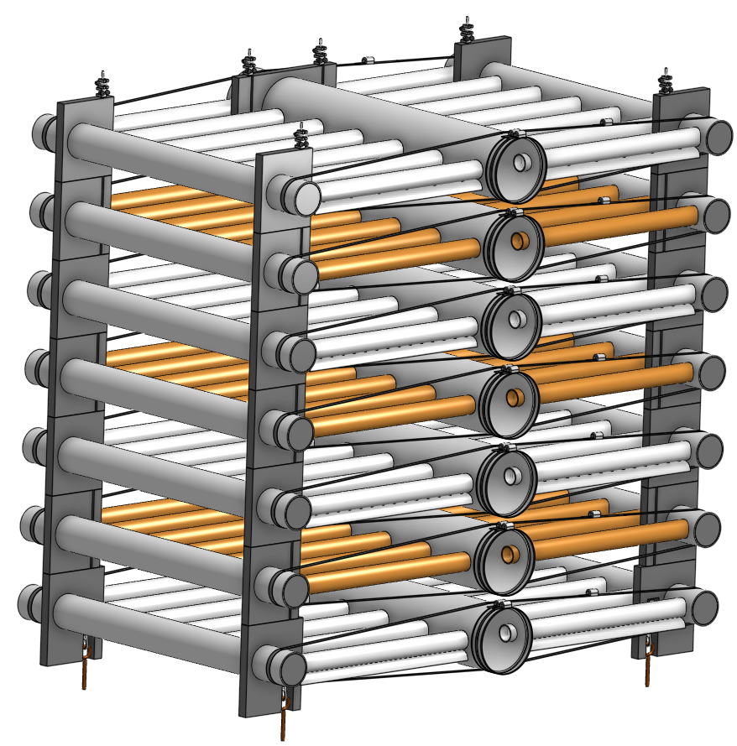
32
31
30
28
29
33
11
35
Notes:
filter_internal_piping_modules

Slide 37
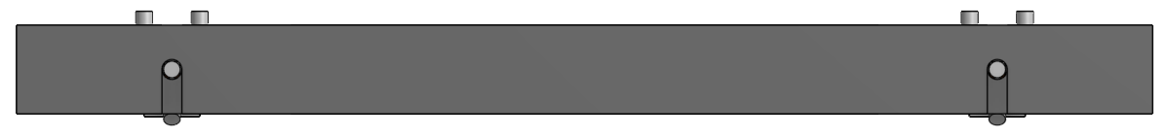
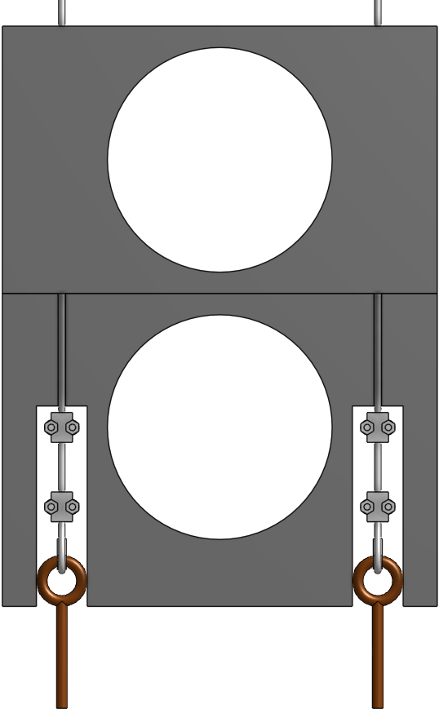
34
31
33
Notes:
filter_trunk_spacer_front_and_top

Slide 38
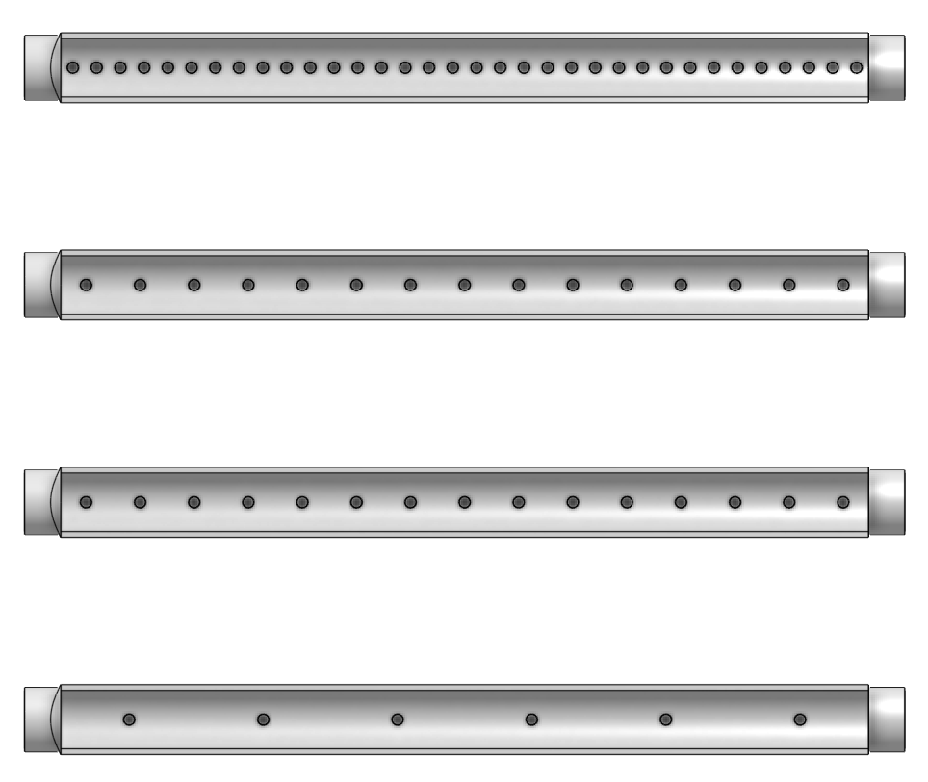
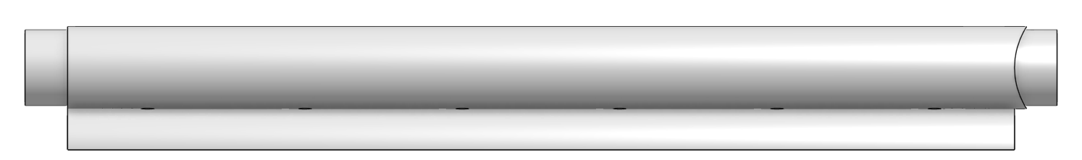
Notes:
filter_inlet_branches

Slide 39
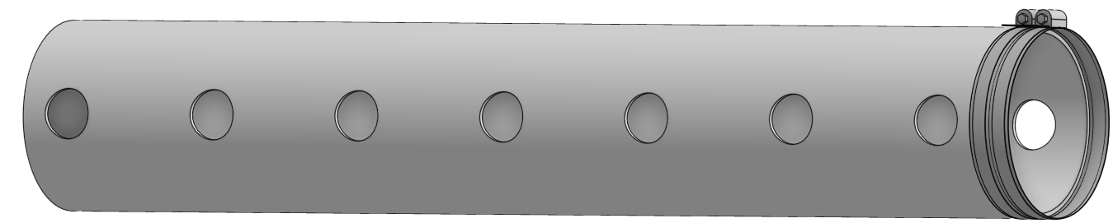
Notes:
filter_trunk_isometric

Slide 40
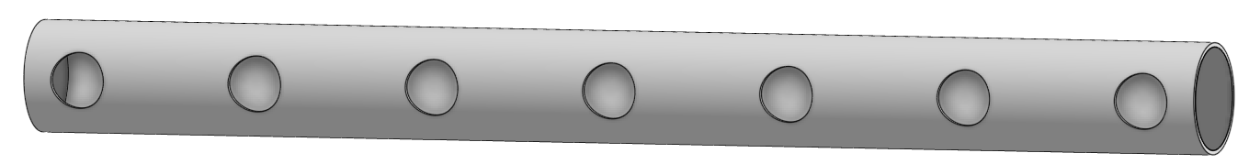
Notes:
filter_receptor_isometric

Slide 41
Chemical Stock Tanks

Slide 42
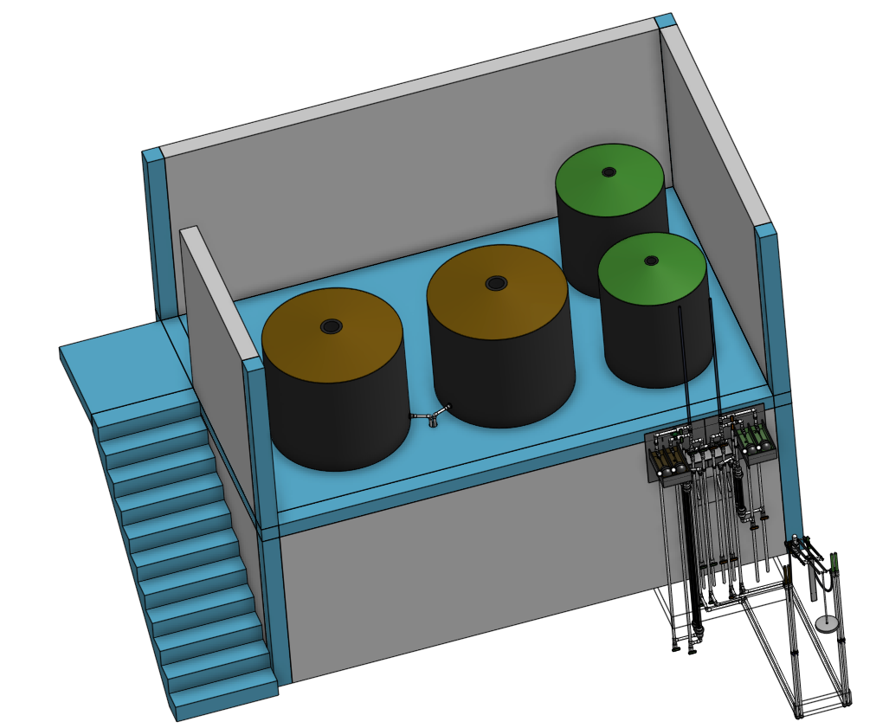
3
1
2

Slide 43
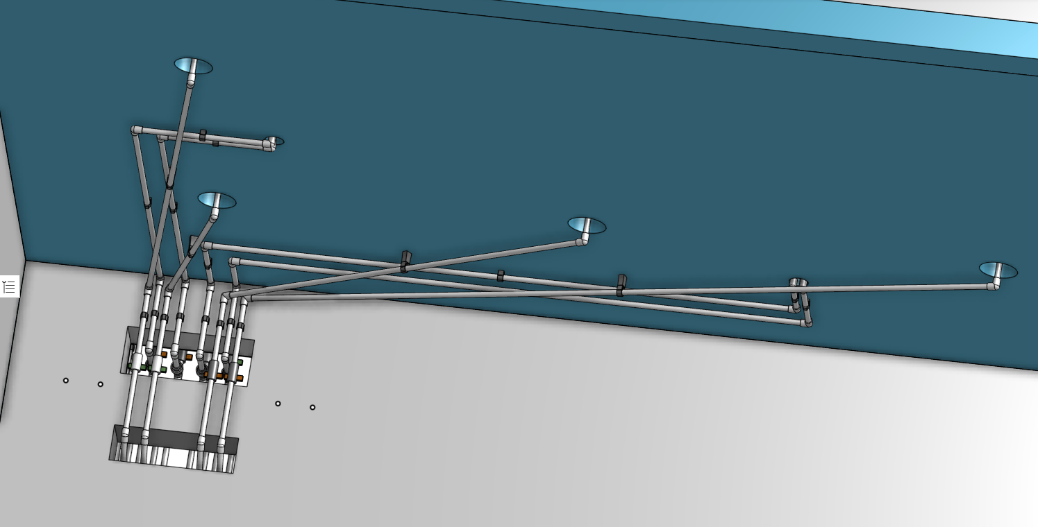
4
8
5
7
6

Slide 44
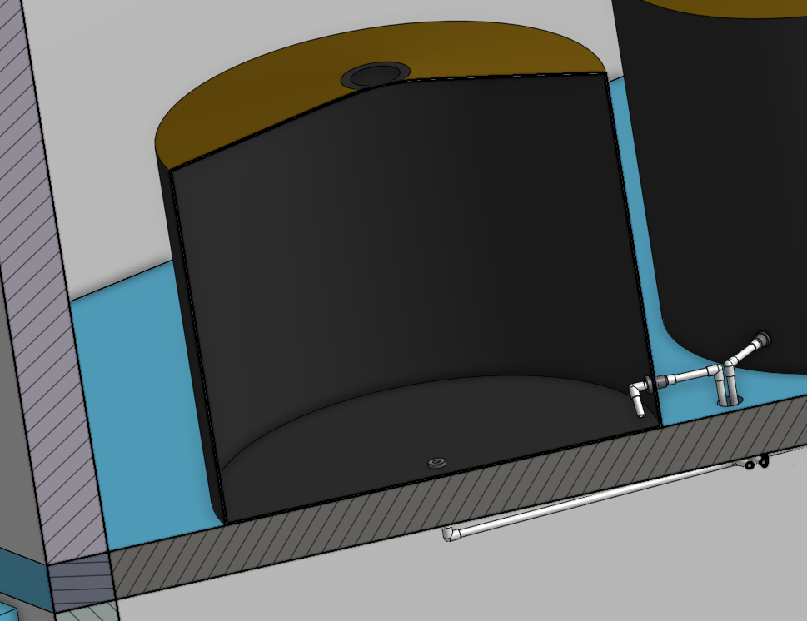
9
10
11

Slide 45
Chemical Dose Controller

Slide 46

2
3
1
4
9
8
7
6
5

Slide 47
Injection Points

Slide 48

3
2
1

Slide 49

4
5
6
8
7

Slide 50

11
13
15
14
12
11
6
9&10

